Slide 1





How do resource abundance and stochasticity affect animal movement?
Stefano Mezzini – Ph.D. Biol.

Slide 2
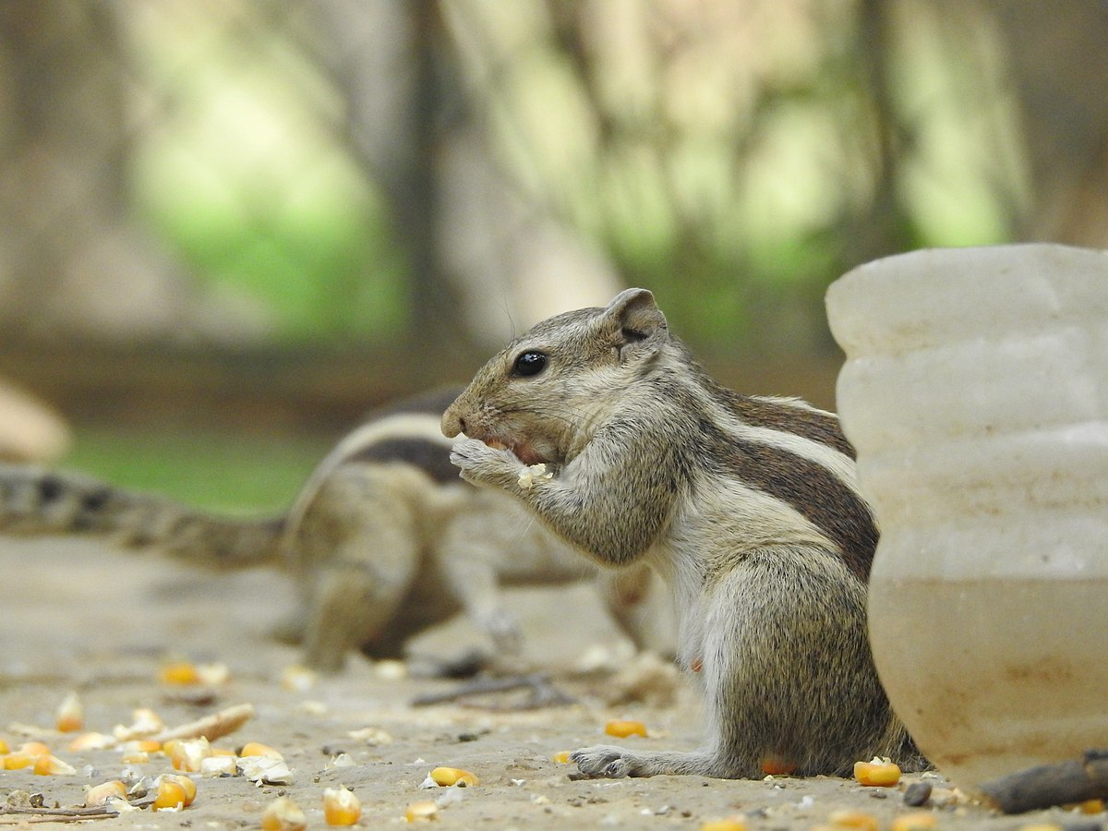
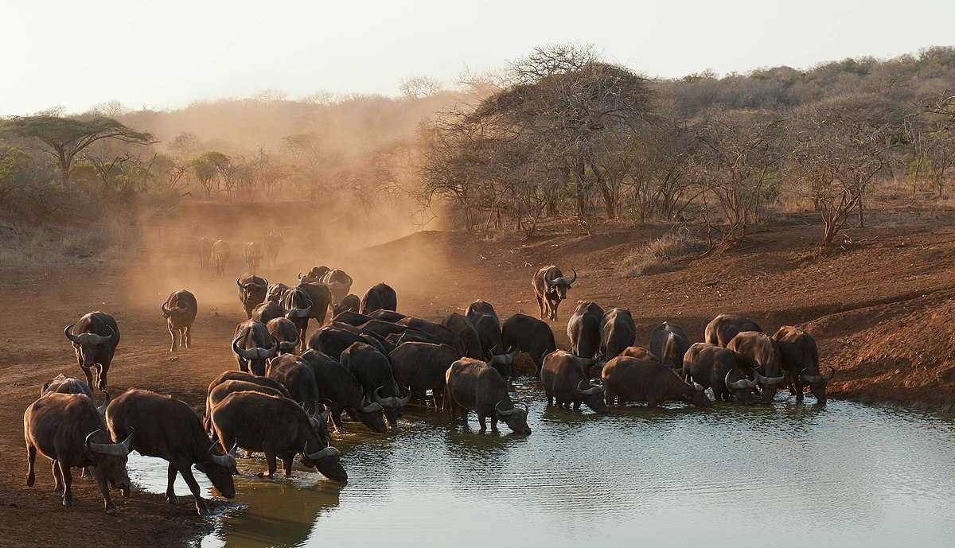
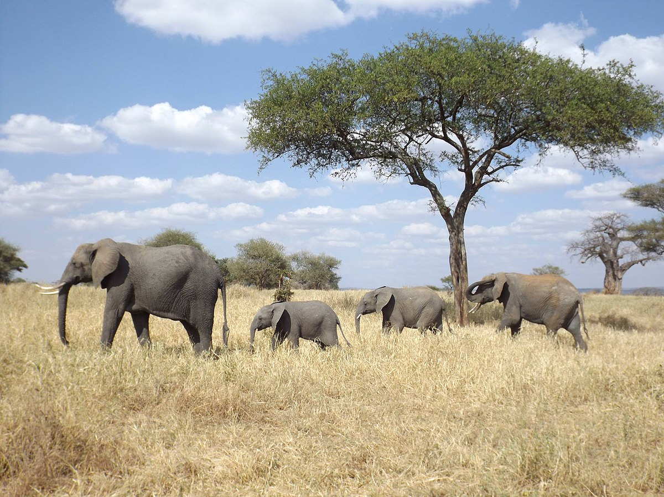
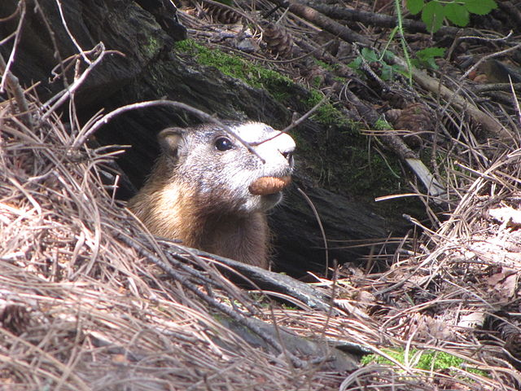
Why do animals move?
photo by safaritravelplus, CC0, via Wikimedia Commons
Food/nutrients
Water
New den/nest
Mate/group
And many other reasons…
Use home range size as a proxy for all needs
photo by Prashant Saini, CC BY-SA 4.0, via Wikimedia Commons
photo by Floodmfx, CC0, via Wikimedia Commons
photo by Njschock, CC BY-SA 3.0, via Wikimedia Commons

Slide 3
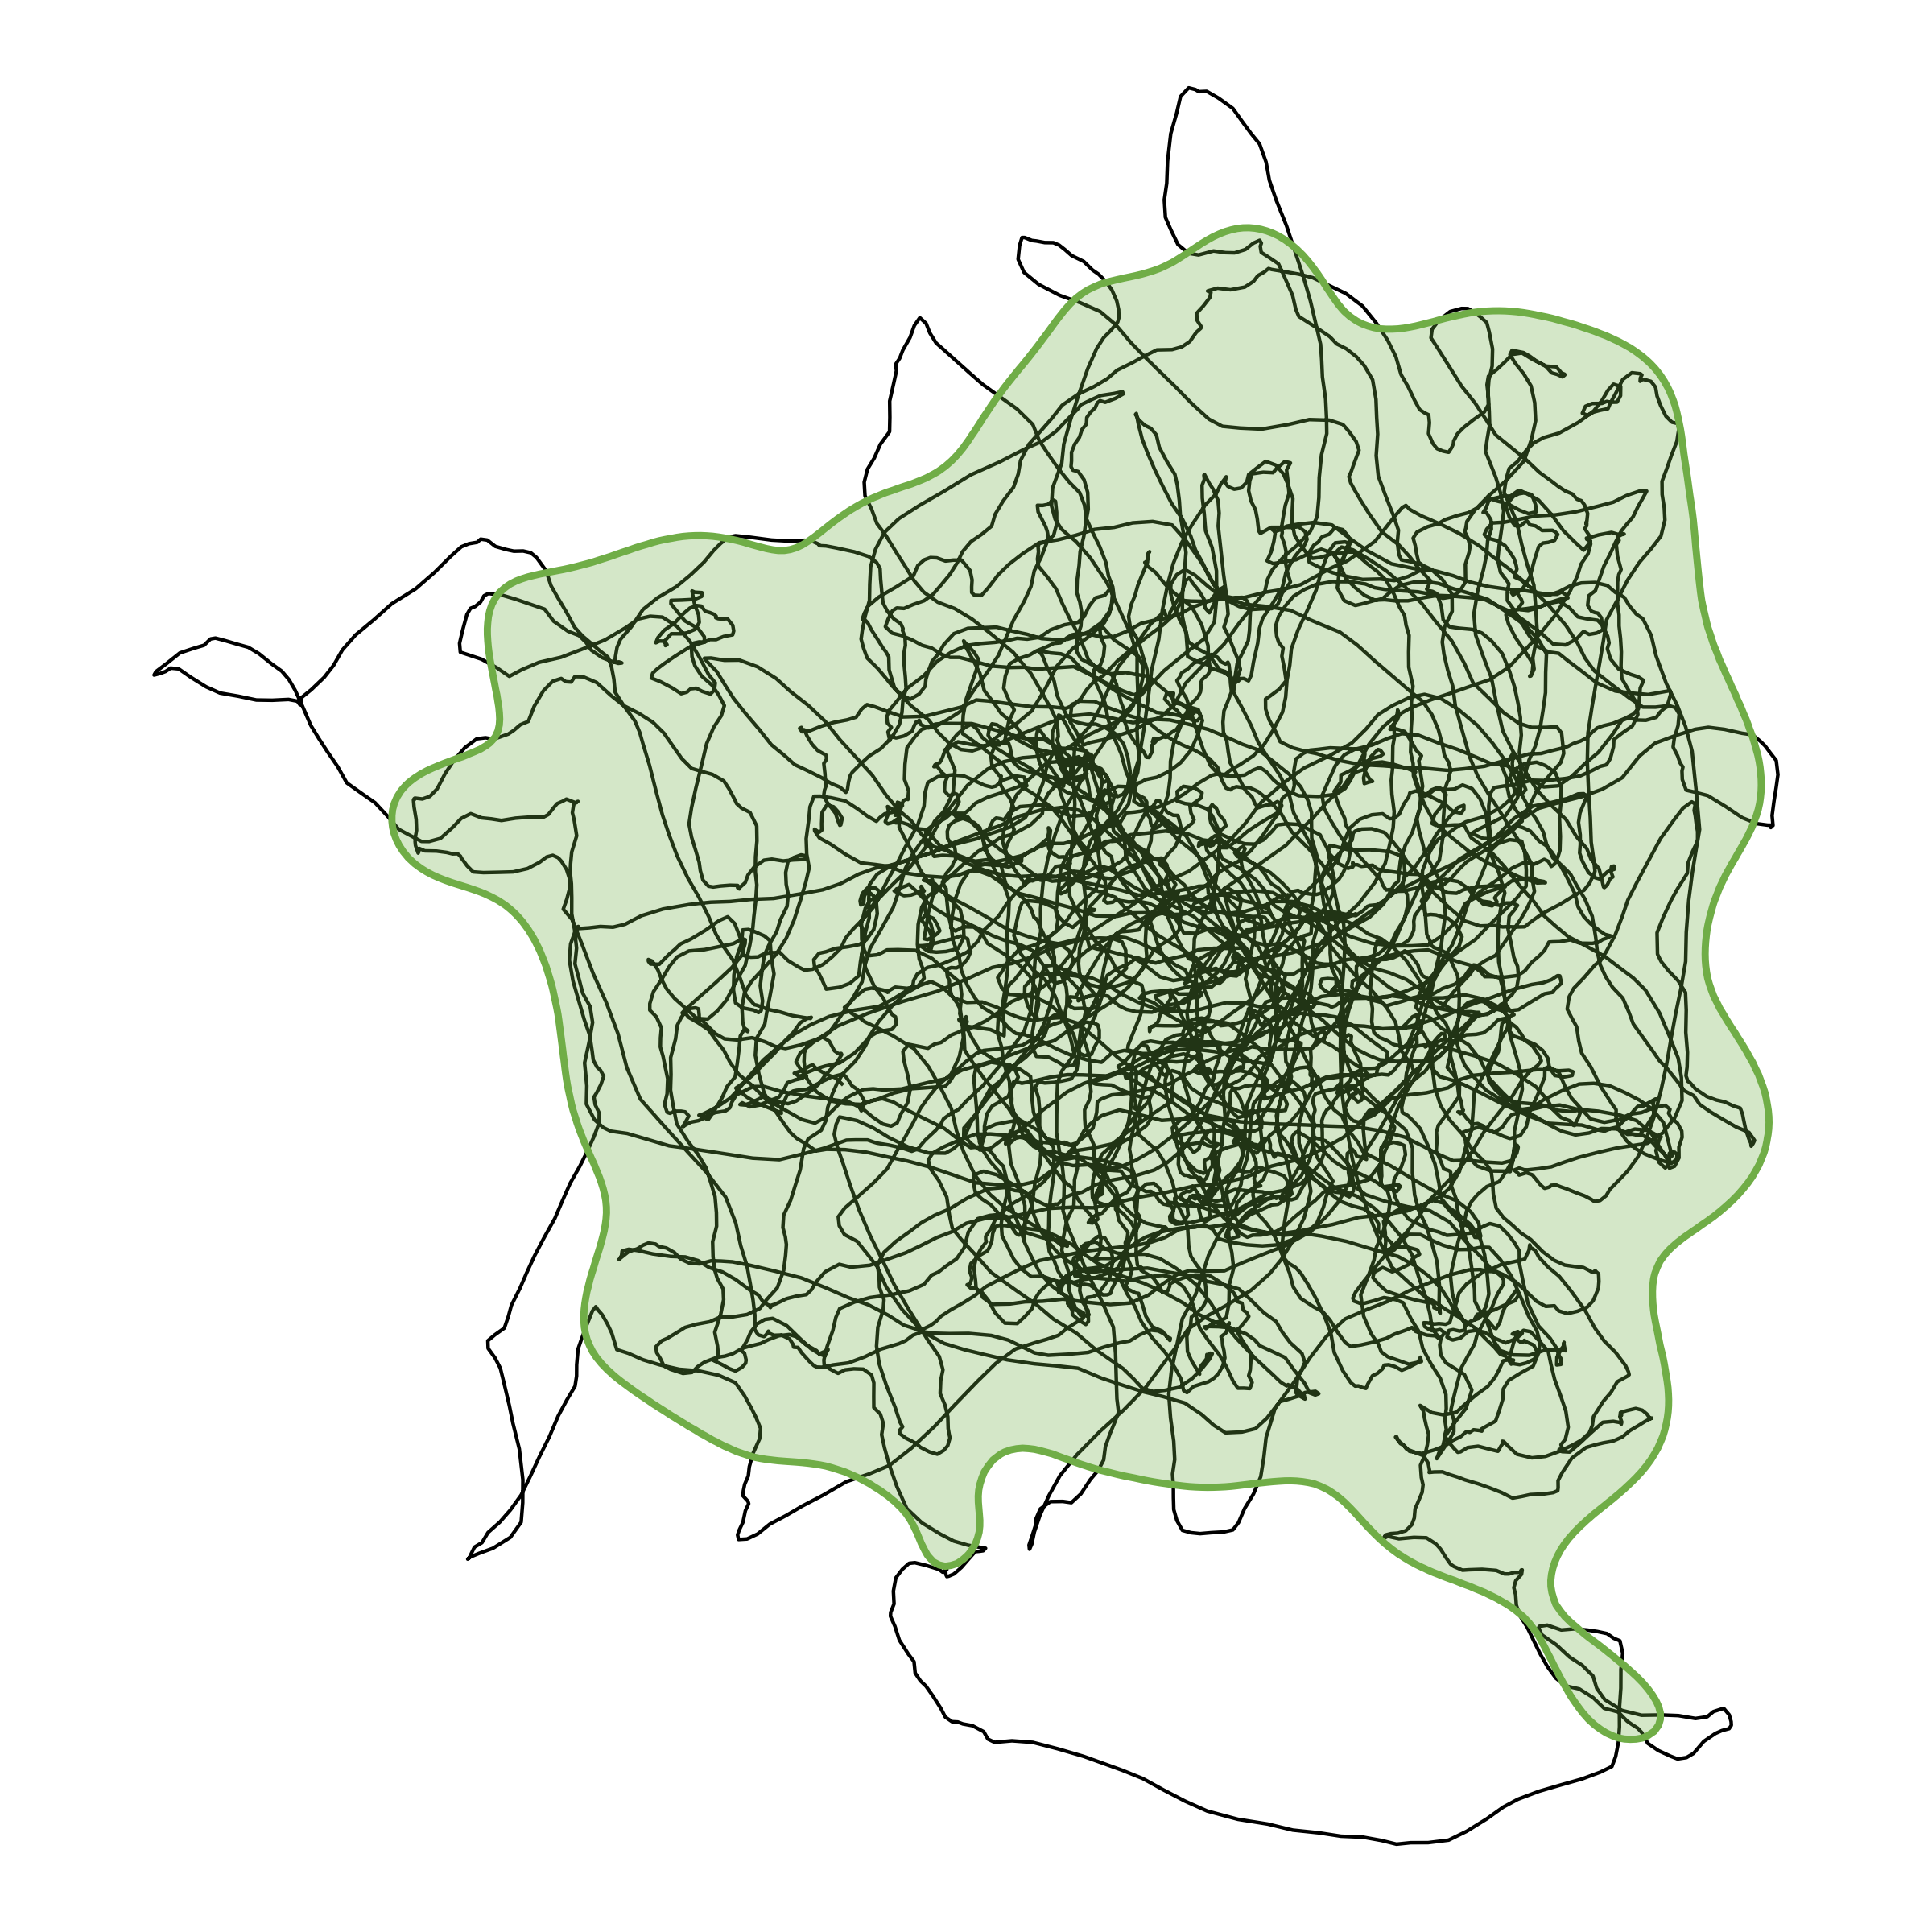
What is a home range?
Area required for essential needs
Excludes exploratory paths
HR must have a stable centroid
Not applicable to:
Nomadic animals
Migrating animals

Slide 4
Examples of a stable centroid
An eagle returning to its nest
A bear returning to its den
A bee returning to its hive
The center of a coyote’s hunting grounds
The center of a deer’s foraging grounds

Slide 5
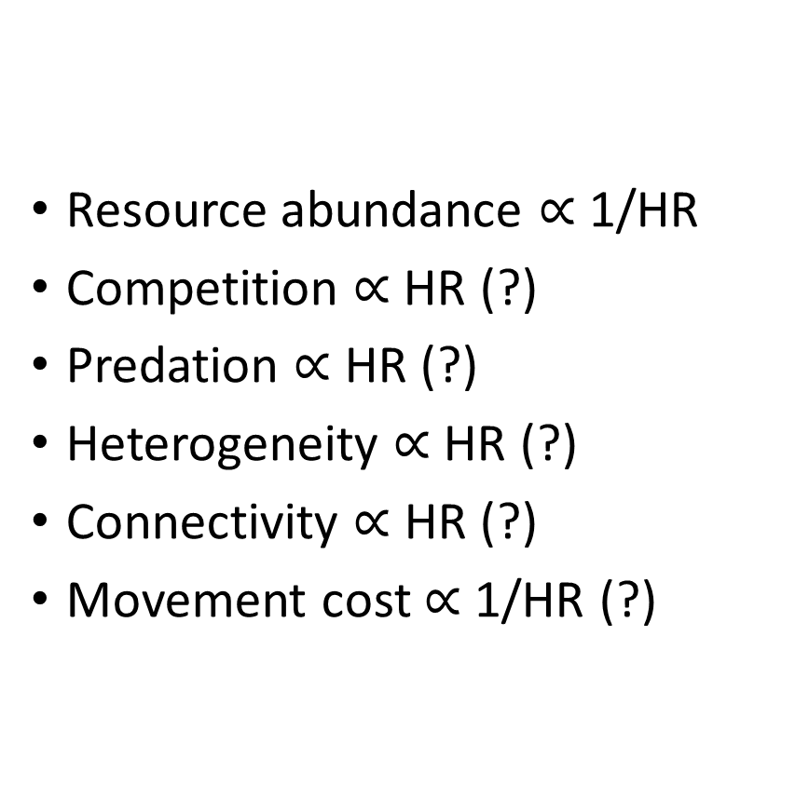
What might affect home range size?
Resource abundance $∝$ 1/HR
Competition $∝$ HR (?)
Predation $∝$ HR (?)
Heterogeneity $∝$ HR (?)
Connectivity $∝$ HR (?)
Movement cost $∝$ 1/HR (?)

Slide 6
Resource abundance and HR

Slide 7

Resource abundance and HR: examples
Photo by Ray Hennessy on Unsplash

Slide 8
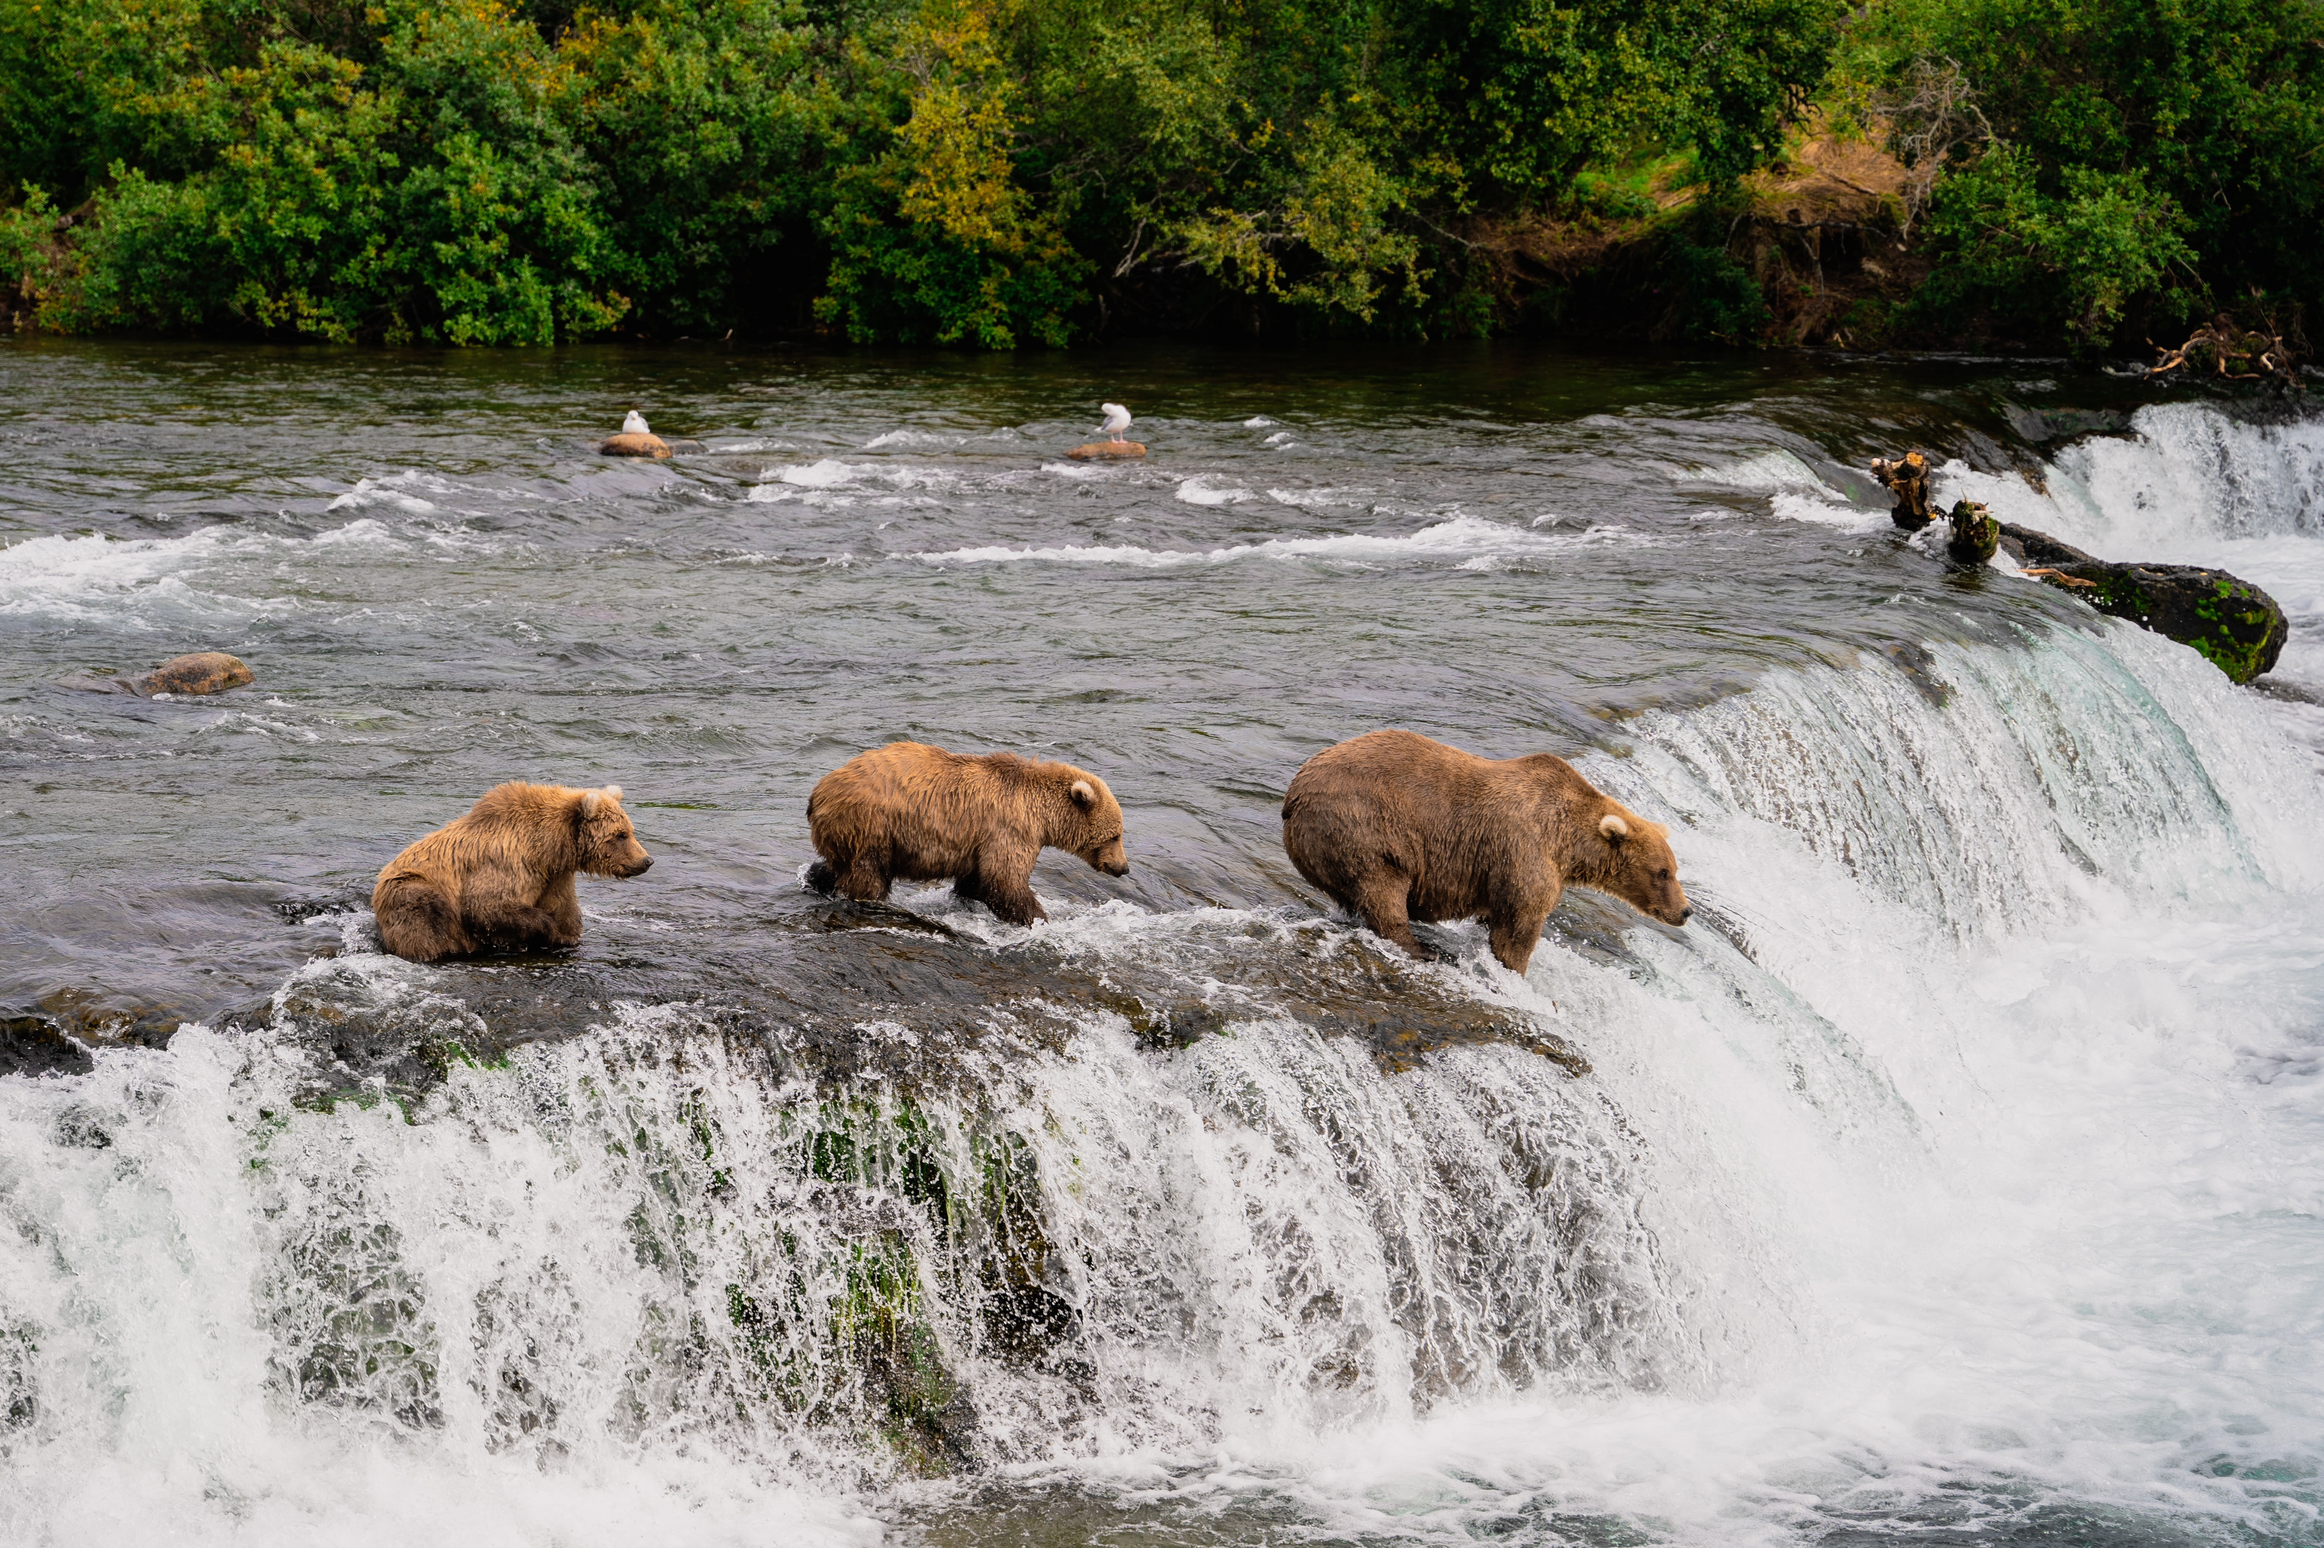
Resource abundance and HR: examples
Photo by Pradeep Nayak on Unsplash

Slide 9
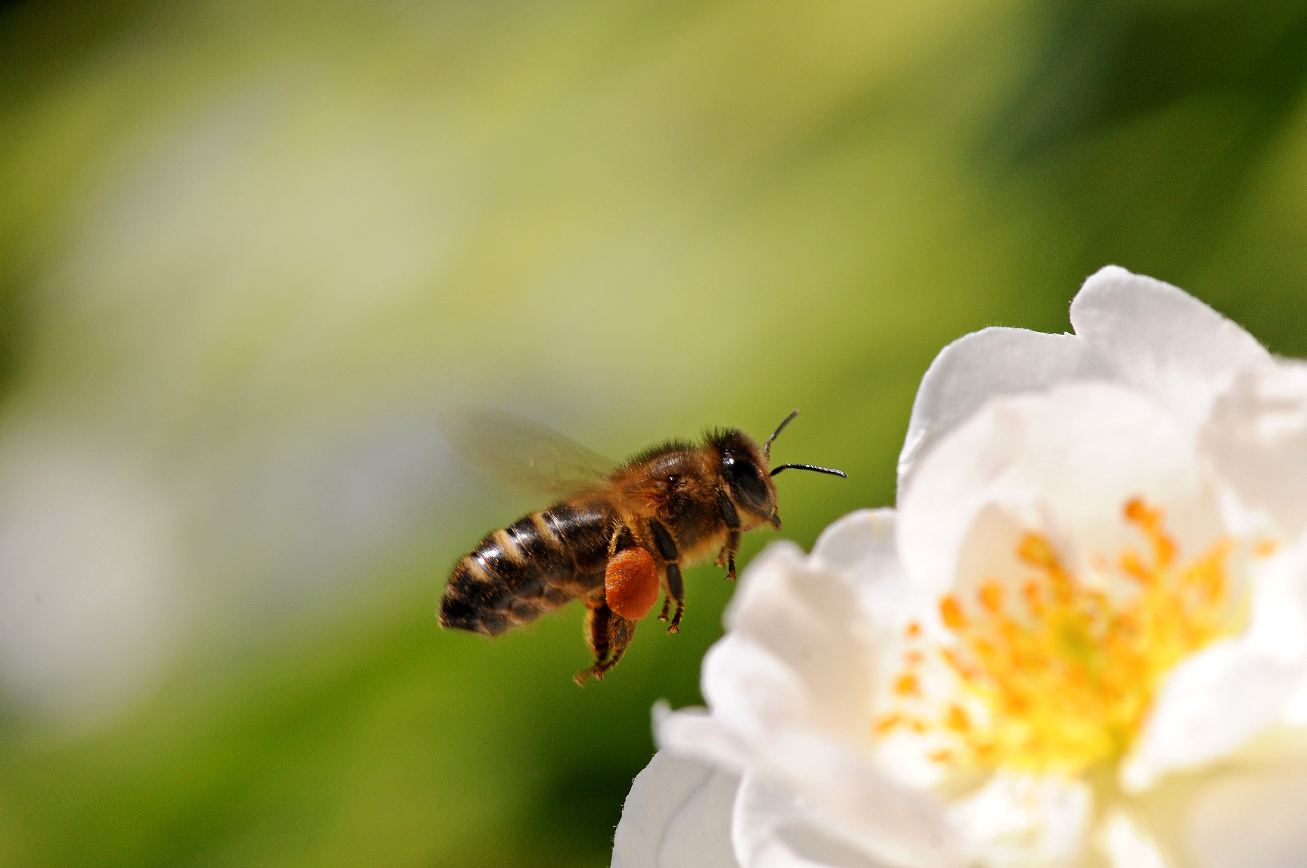
Resource abundance and HR: examples
Photo by Kieran Murphy on Unsplash

Slide 10
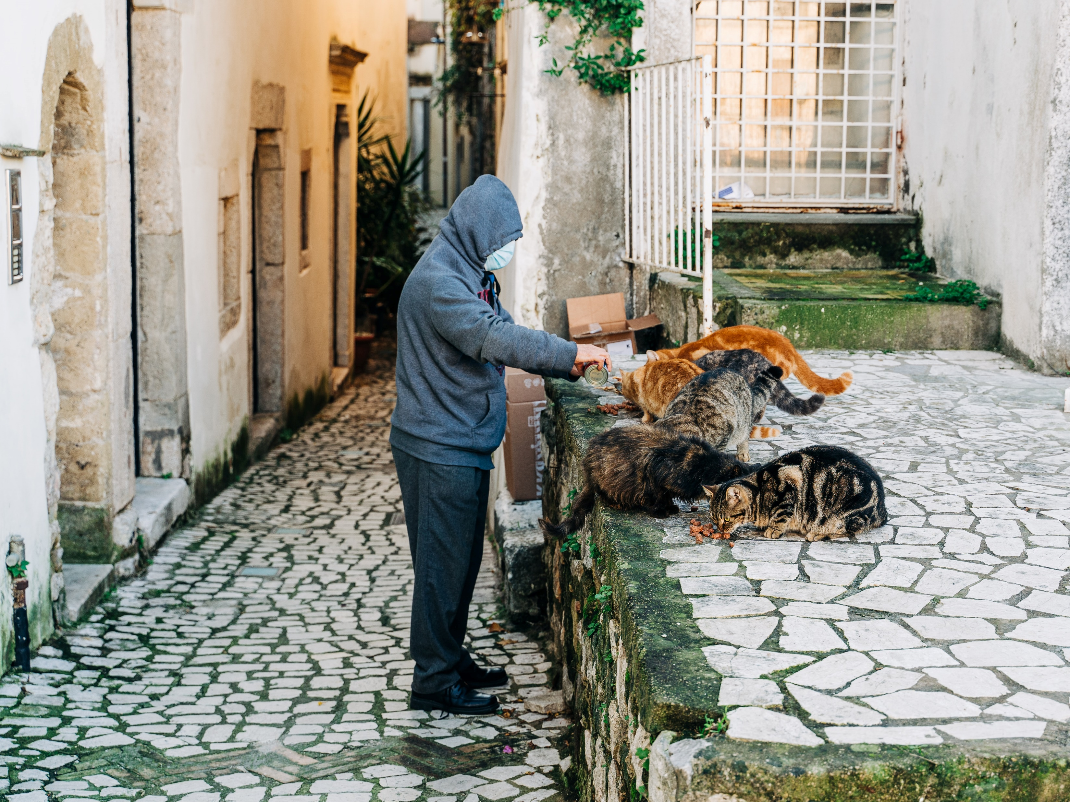
Resource abundance and HR: examples
Photo by Gabriella Clare Marino on Unsplash

Slide 11
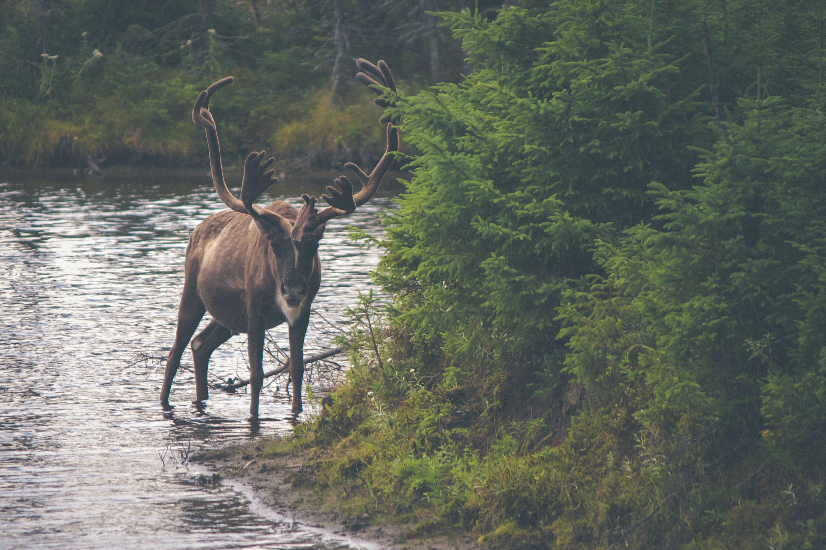
Resource abundance and HR: examples
Photo by Thomas Lefebvre on Unsplash

Slide 12
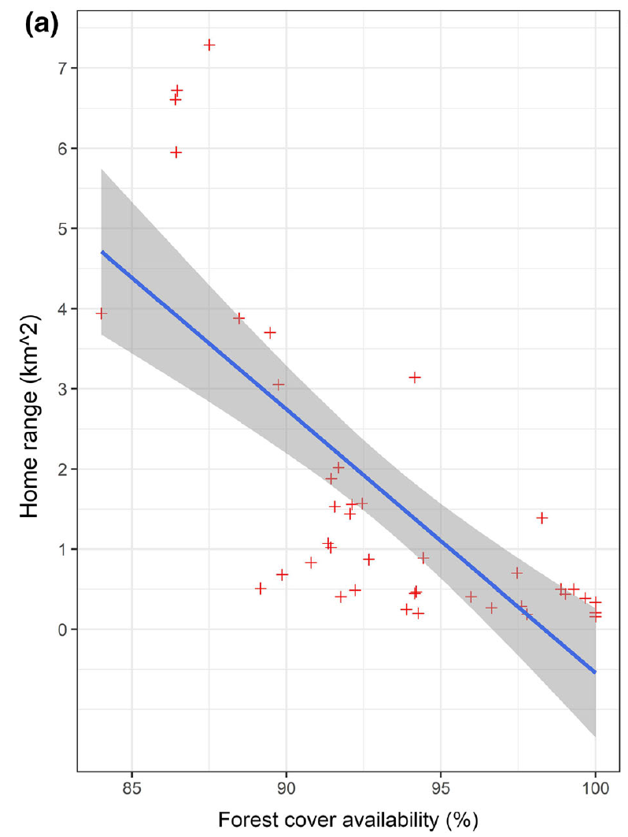
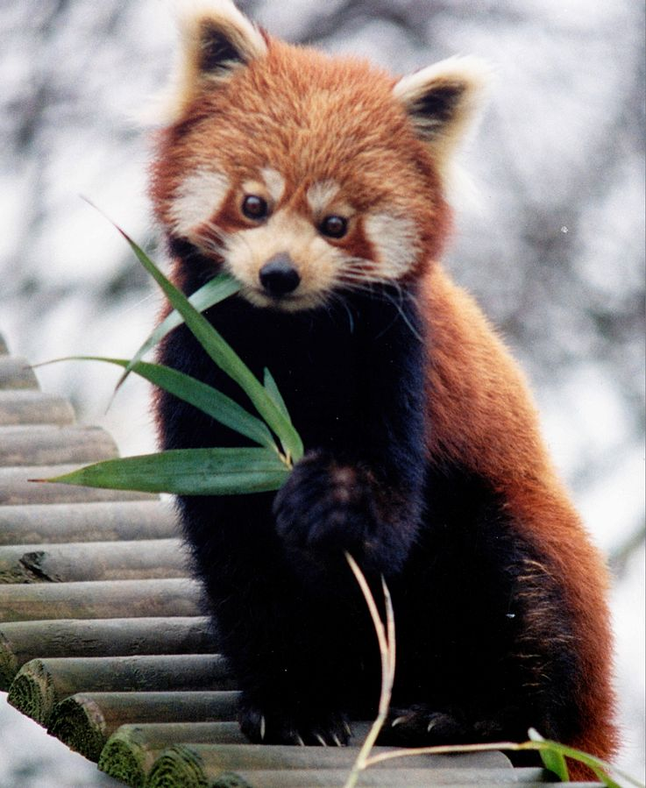
Resource abundance and HR: examples in literature
HR size (km²)
Photo by Brunswyk on Wikimedia Commons
Forest cover (%)
(Bista et al. 2022)

Slide 13
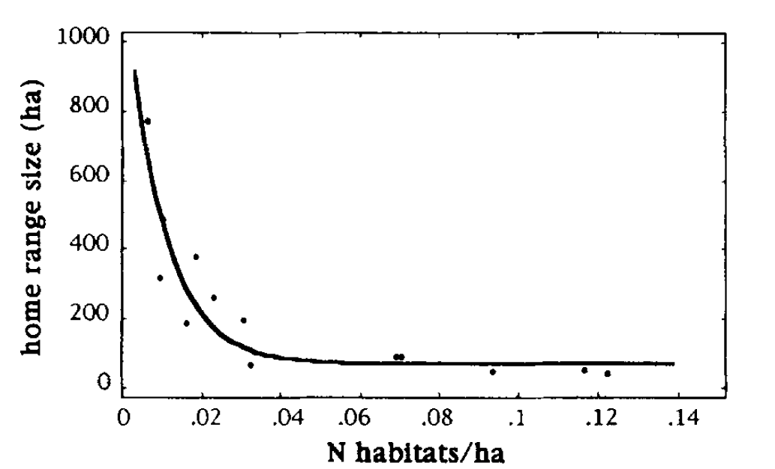
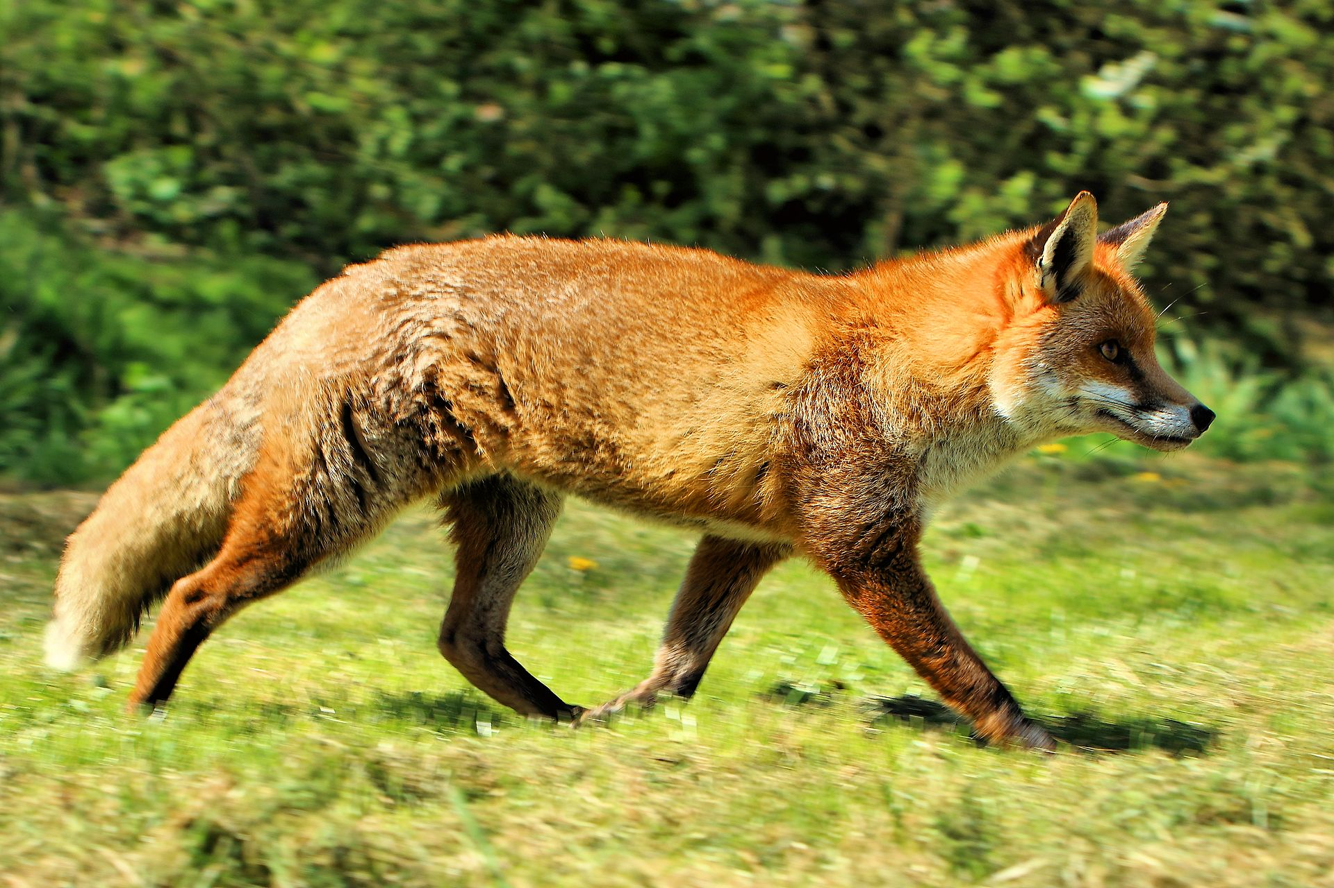
Resource abundance and HR: examples in literature
HR size (ha)
Photo by Airwolfhound on Wikimedia Commons
Resource abundance (habitats/ha)
(Lucherini & Lovari 1996)

Slide 14
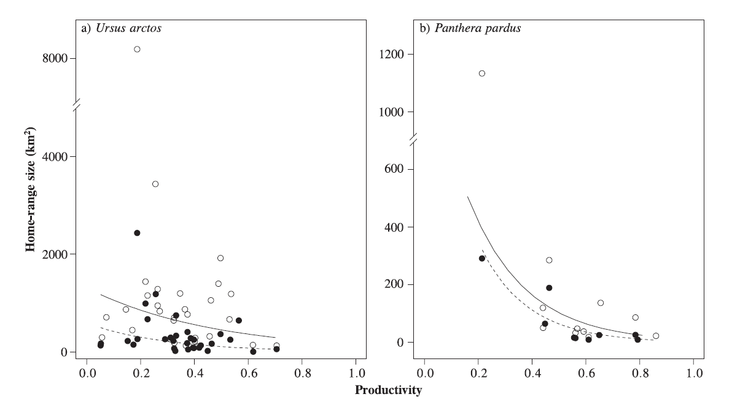
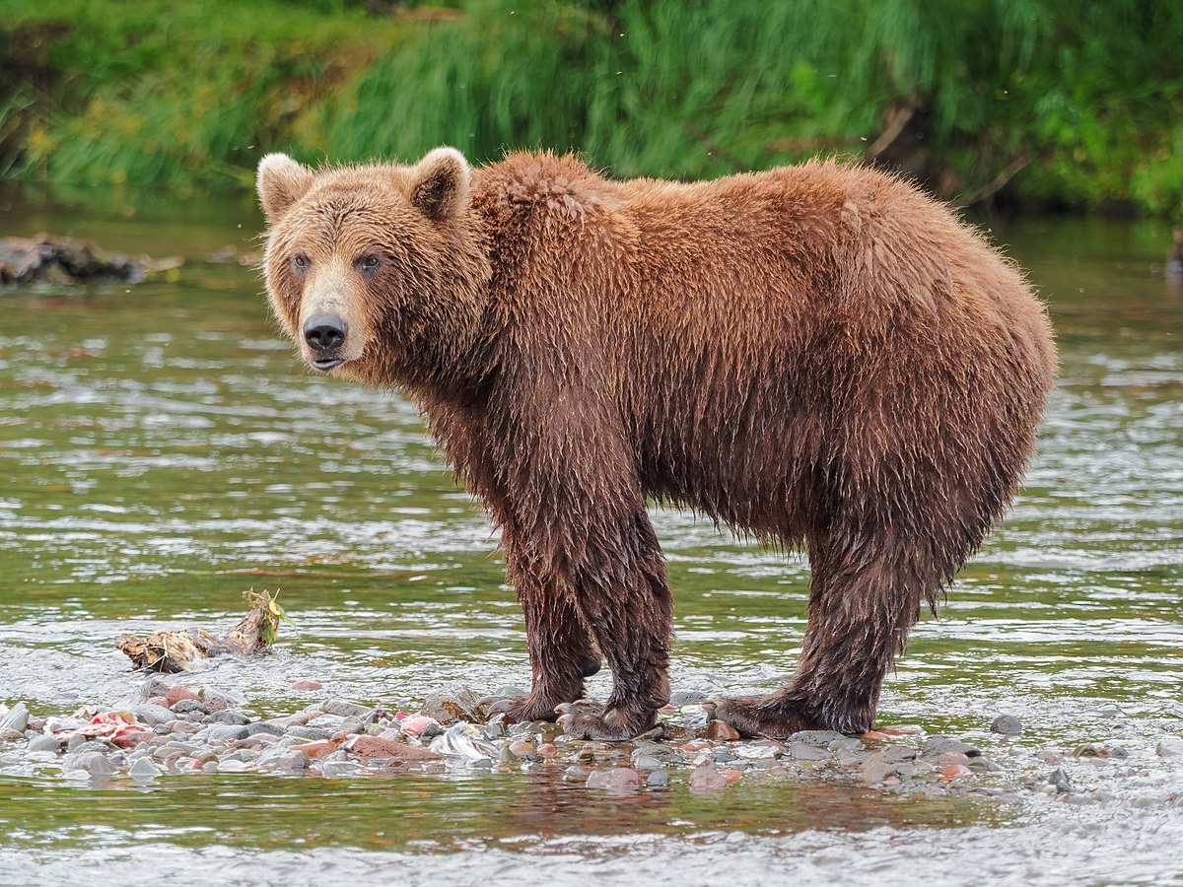
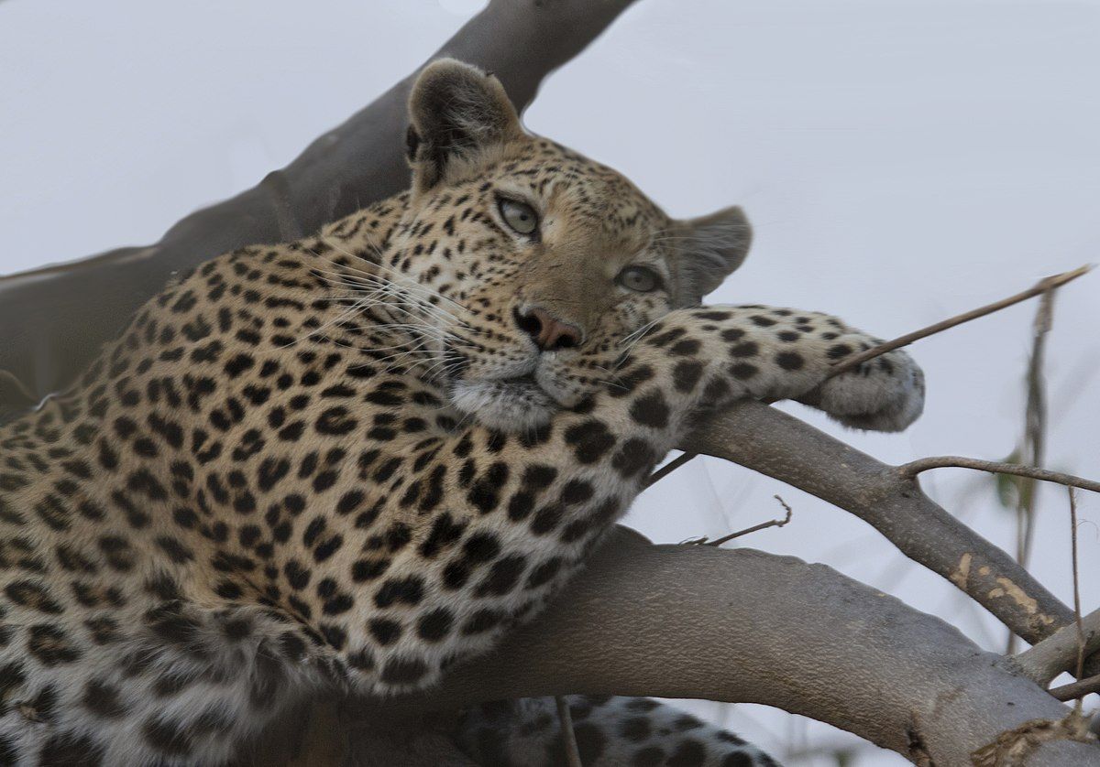
Resource abundance and HR: examples in literature
Photo by Robert F. Tobleron Wikimedia Commons
Photo by Gregory "Slobirdr" Smith on Wikimedia Commons
HR size (km²)
Productivity (NDVI)
(Nilsen et al. 2005)

Slide 15
Resource abundance and HR: an abundance of evidence
Bista, D., G. S. Baxter, N. J. Hudson, S. T. Lama, and P. J. Murray. 2022. Effect of disturbances and habitat fragmentation on an arboreal habitat specialist mammal using GPS telemetry: A case of the red panda. Landscape Ecology 37:795–809.
Geremia, C., J. A. Merkle, D. R. Eacker, R. L. Wallen, P. J. White, M. Hebblewhite, and M. J. Kauffman. 2019. Migrating bison engineer the green wave. Proceedings of the National Academy of Sciences 116:25707–25713.
Herfindal, I., J. D. C. Linnell, J. Odden, E. B. Nilsen, and R. Andersen. 2005. Prey density, environmental productivity and home-range size in the Eurasian lynx (Lynx lynx). Journal of Zoology 265:63–71.
Lucherini, M., and S. Lovari. 1996. Habitat richness affects home range size in the red fox Vulpes vulpes. Behavioural Processes 36:103–105.
Nilsen, E. B., I. Herfindal, and J. D. C. Linnell. 2005. Can intra-specific variation in carnivore home-range size be explained using remote-sensing estimates of environmental productivity? Écoscience 12:68–75.
Relyea, R. A., R. K. Lawrence, and S. Demarais. 2000. Home Range of Desert Mule Deer: Testing the Body-Size and Habitat-Productivity Hypotheses. The Journal of Wildlife Management 64:146.
Rickbeil, G. J. M., J. A. Merkle, G. Anderson, M. P. Atwood, J. P. Beckmann, E. K. Cole, A. B. Courtemanch, et al. 2019. Plasticity in elk migration timing is a response to changing environmental conditions. Global Change Biology 25:2368–2381.
Williams-Guillen, K., C. McCann, J. C. Martinez Sanchez, and F. Koontz. 2006. Resource availability and habitat use by mantled howling monkeys in a Nicaraguan coffee plantation: Can agroforests serve as core habitat for a forest mammal? Animal Conservation 9:331–338.
…

Slide 16
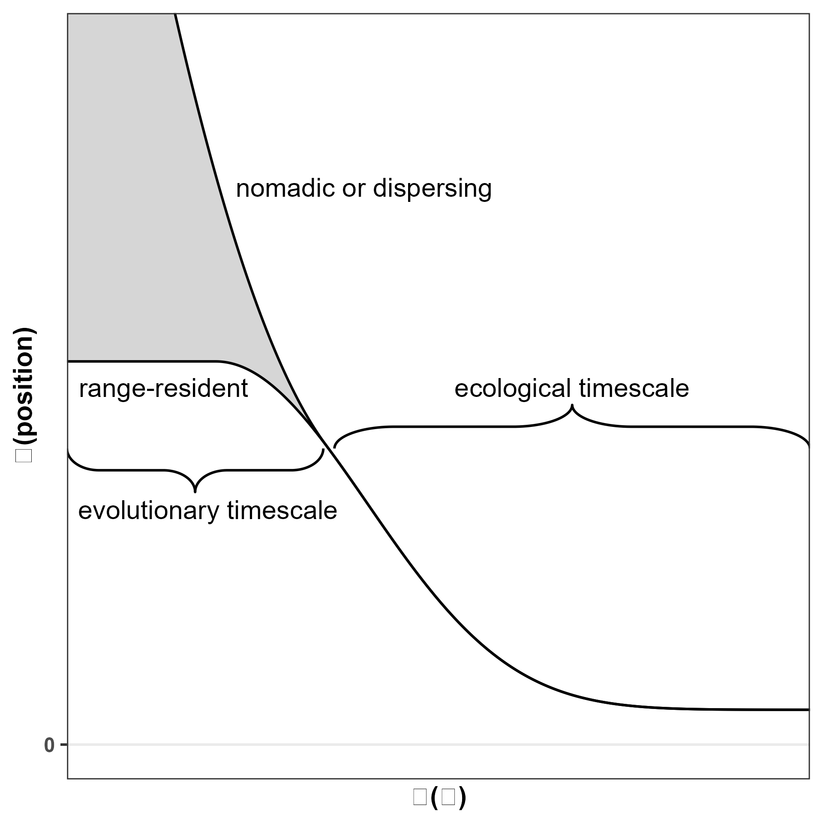
Resource abundance and HR: hypothesis
Home range size
Resource abundance

Slide 17
Resource unpredictability and HR

Slide 18
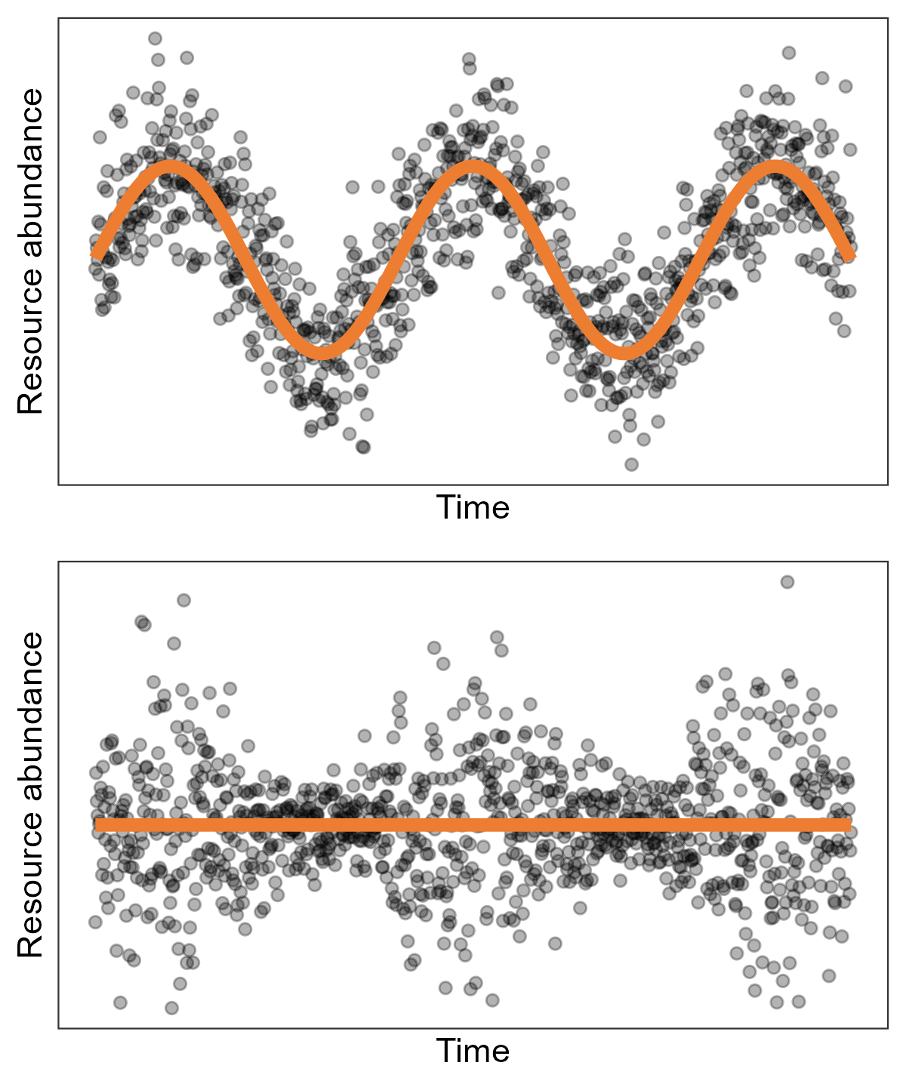
Changes in resource abundance vs resource unpredictability
Predictable changes in the mean:
Different habitats (forest, grassland, …)
Seasonal changes (temp, precip, light, …)
Stochasticity:
Unpredictable events
Extreme and rare events
Climate change
Resource abundance
Resource abundance

Slide 19
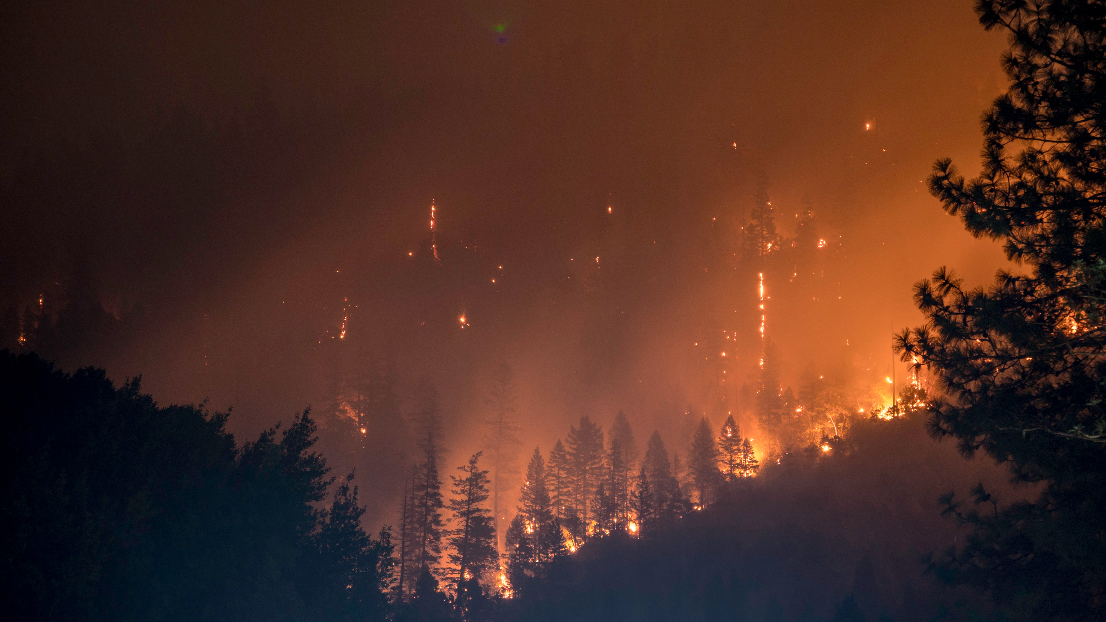
Resource unpredictability and HR: examples
Photo by Matt Howard on Unsplash

Slide 20
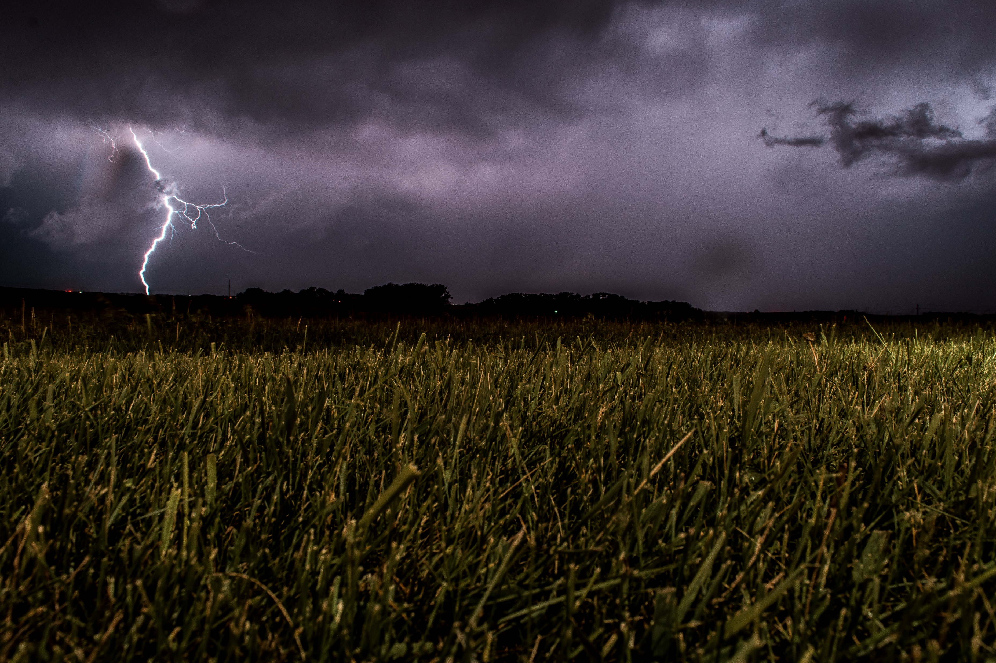
Resource unpredictability and HR: examples
Photo by Eugene Triguba on Unsplash

Slide 21
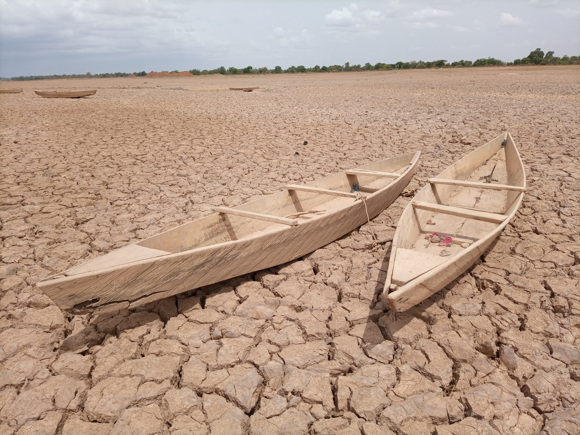
Resource unpredictability and HR: examples
Photo by YODA Adaman on Unsplash

Slide 22
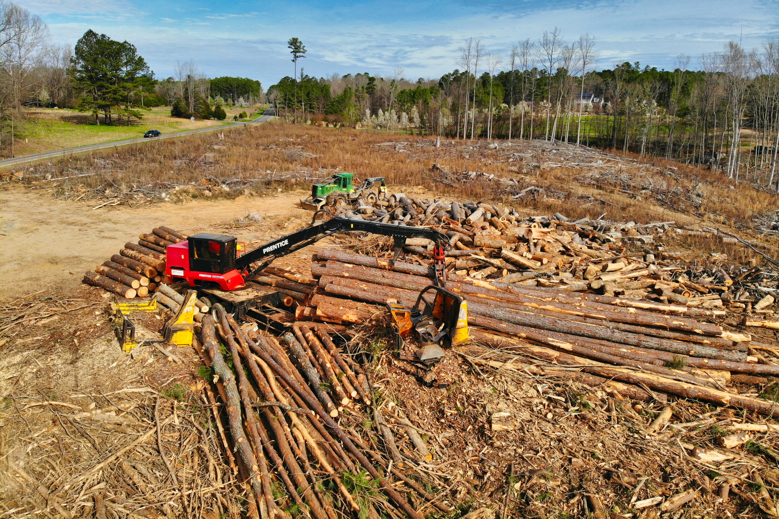
Resource unpredictability and HR: examples
Photo by Gene Gallin on Unsplash

Slide 23
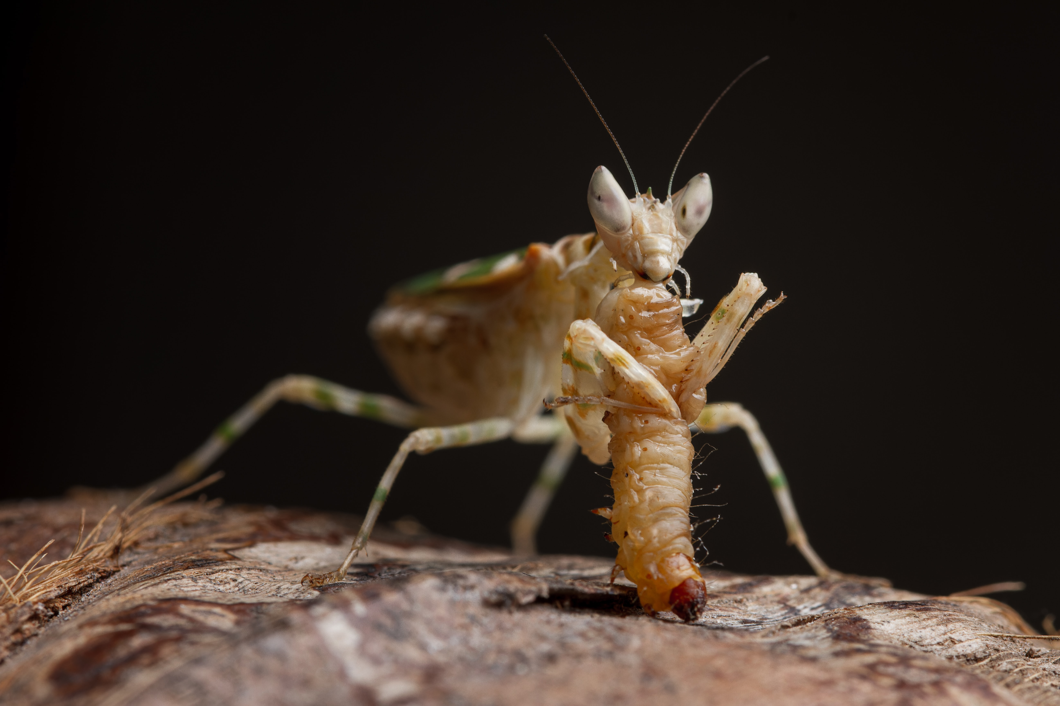
Resource unpredictability and HR: examples
Photo by Peter Law on Unsplash

Slide 24
Resource unpredictability and HR: examples in literature
HR size (ha)
Photo by Airwolfhound on Wikimedia Commons
Resource unpredictability (habitats/ha)
(Lucherini & Lovari 1996)

Slide 25
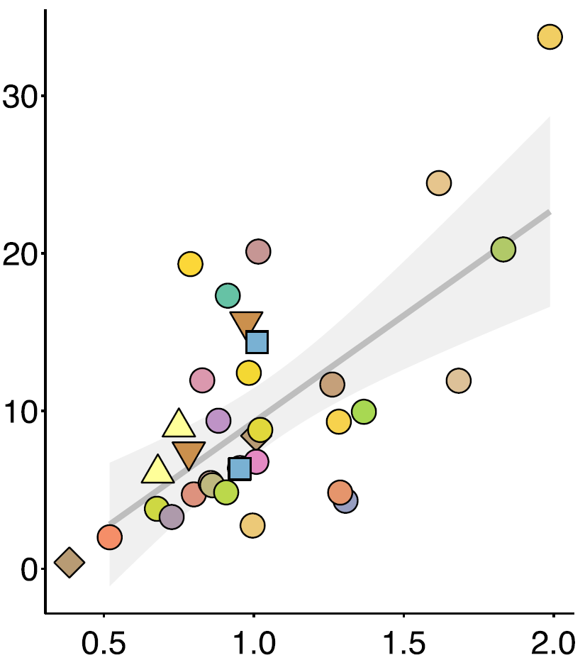
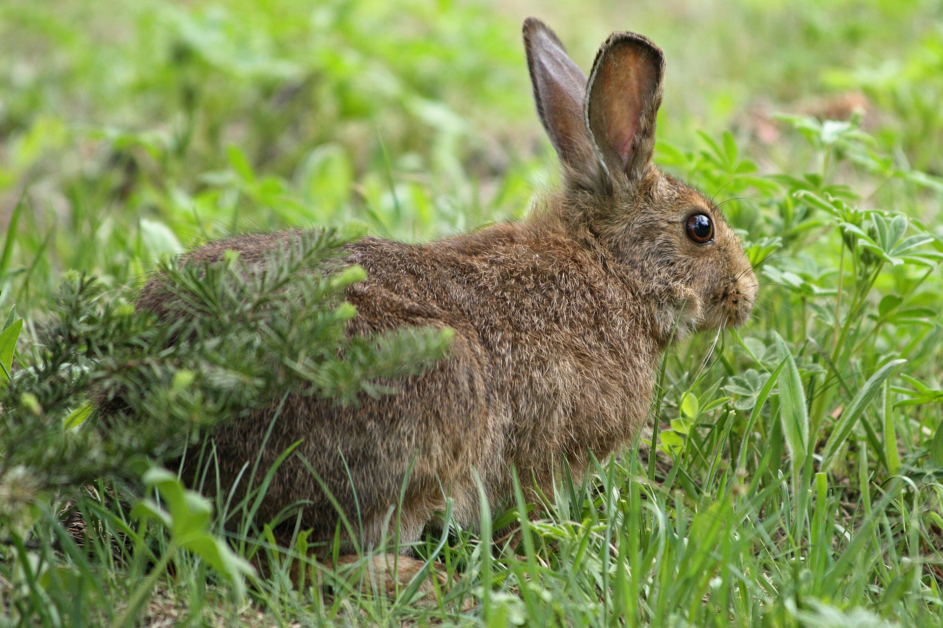
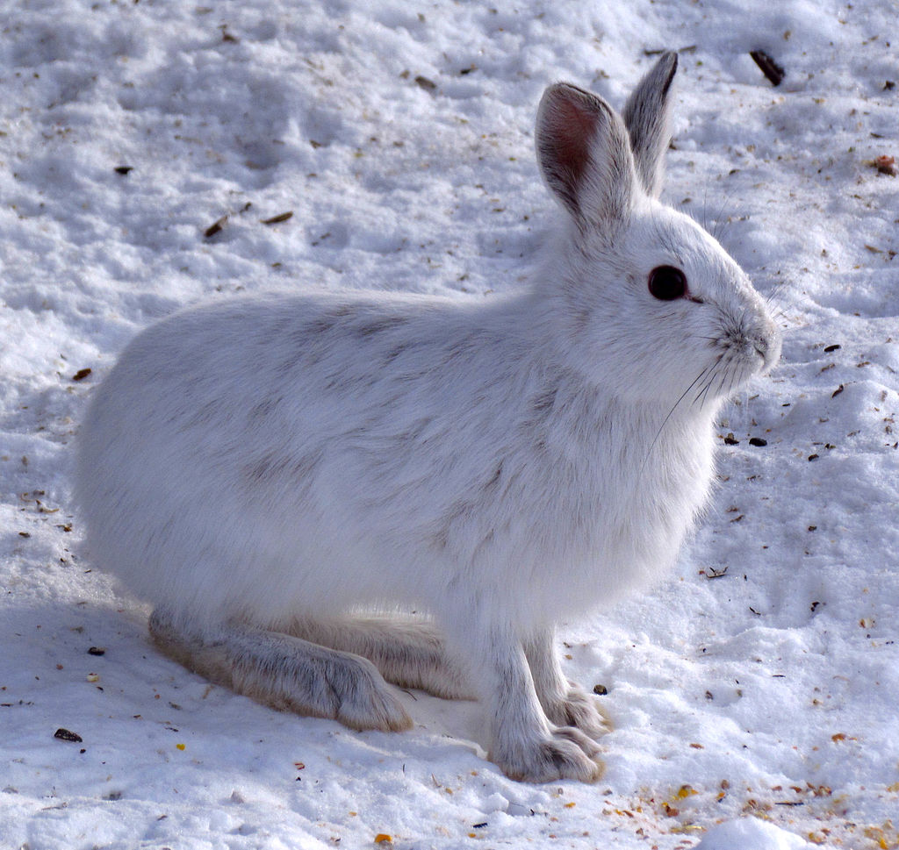
Resource unpredictability and HR: examples in literature
HR size (ha)
Nitrogen unpredictability (CV)
(Rizzuto et al. 2021)
Photos by Wsiegmund (cropped) and D. Gordon E. Robertson on Wikimedia Commons

Slide 26
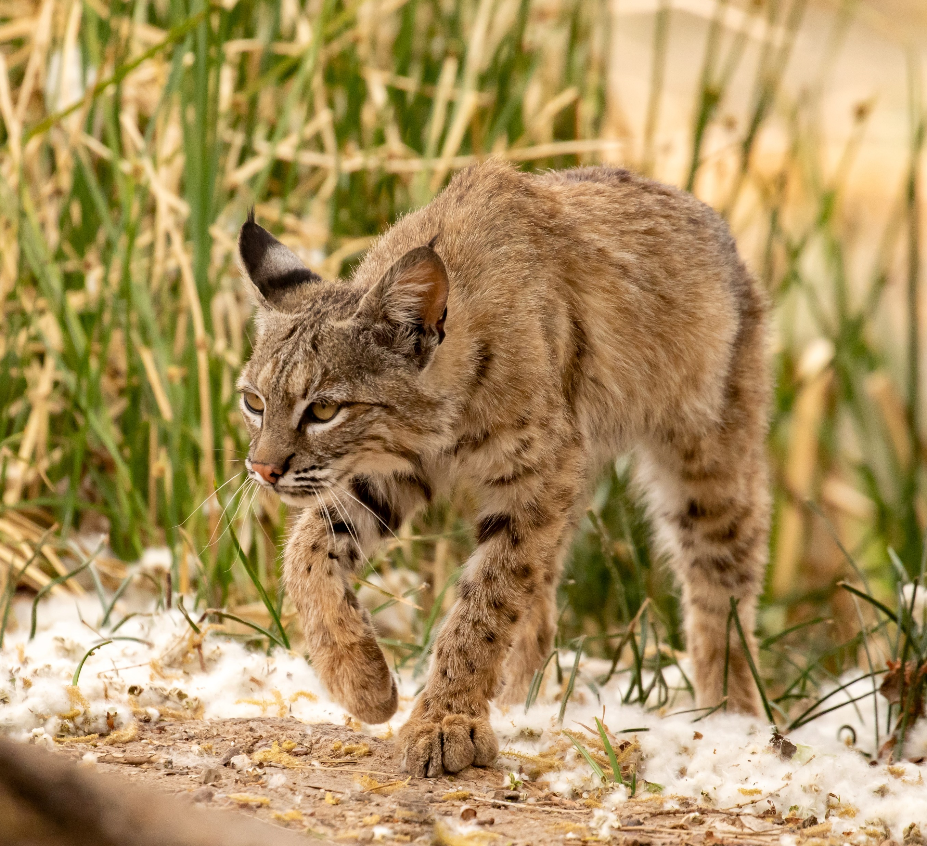
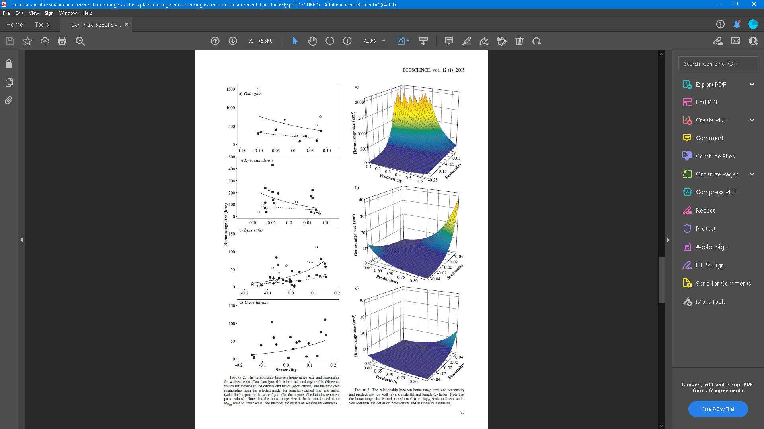
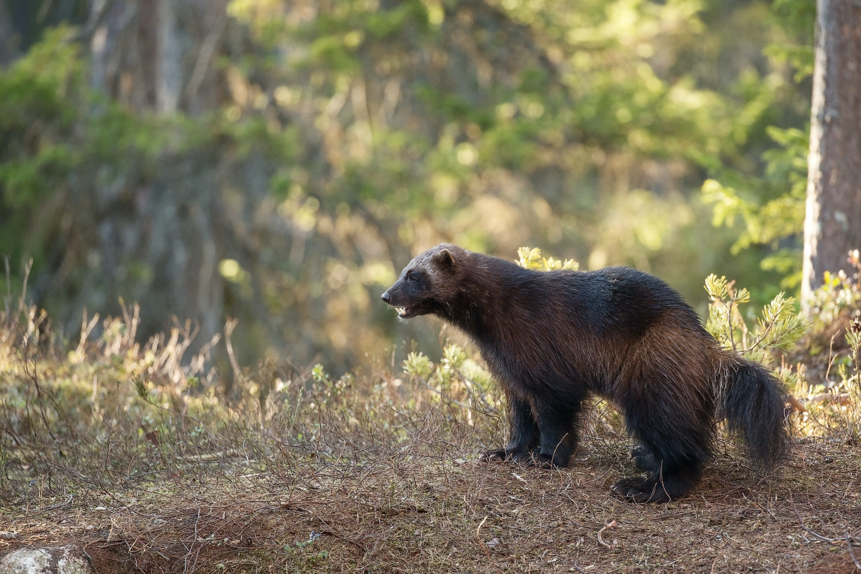
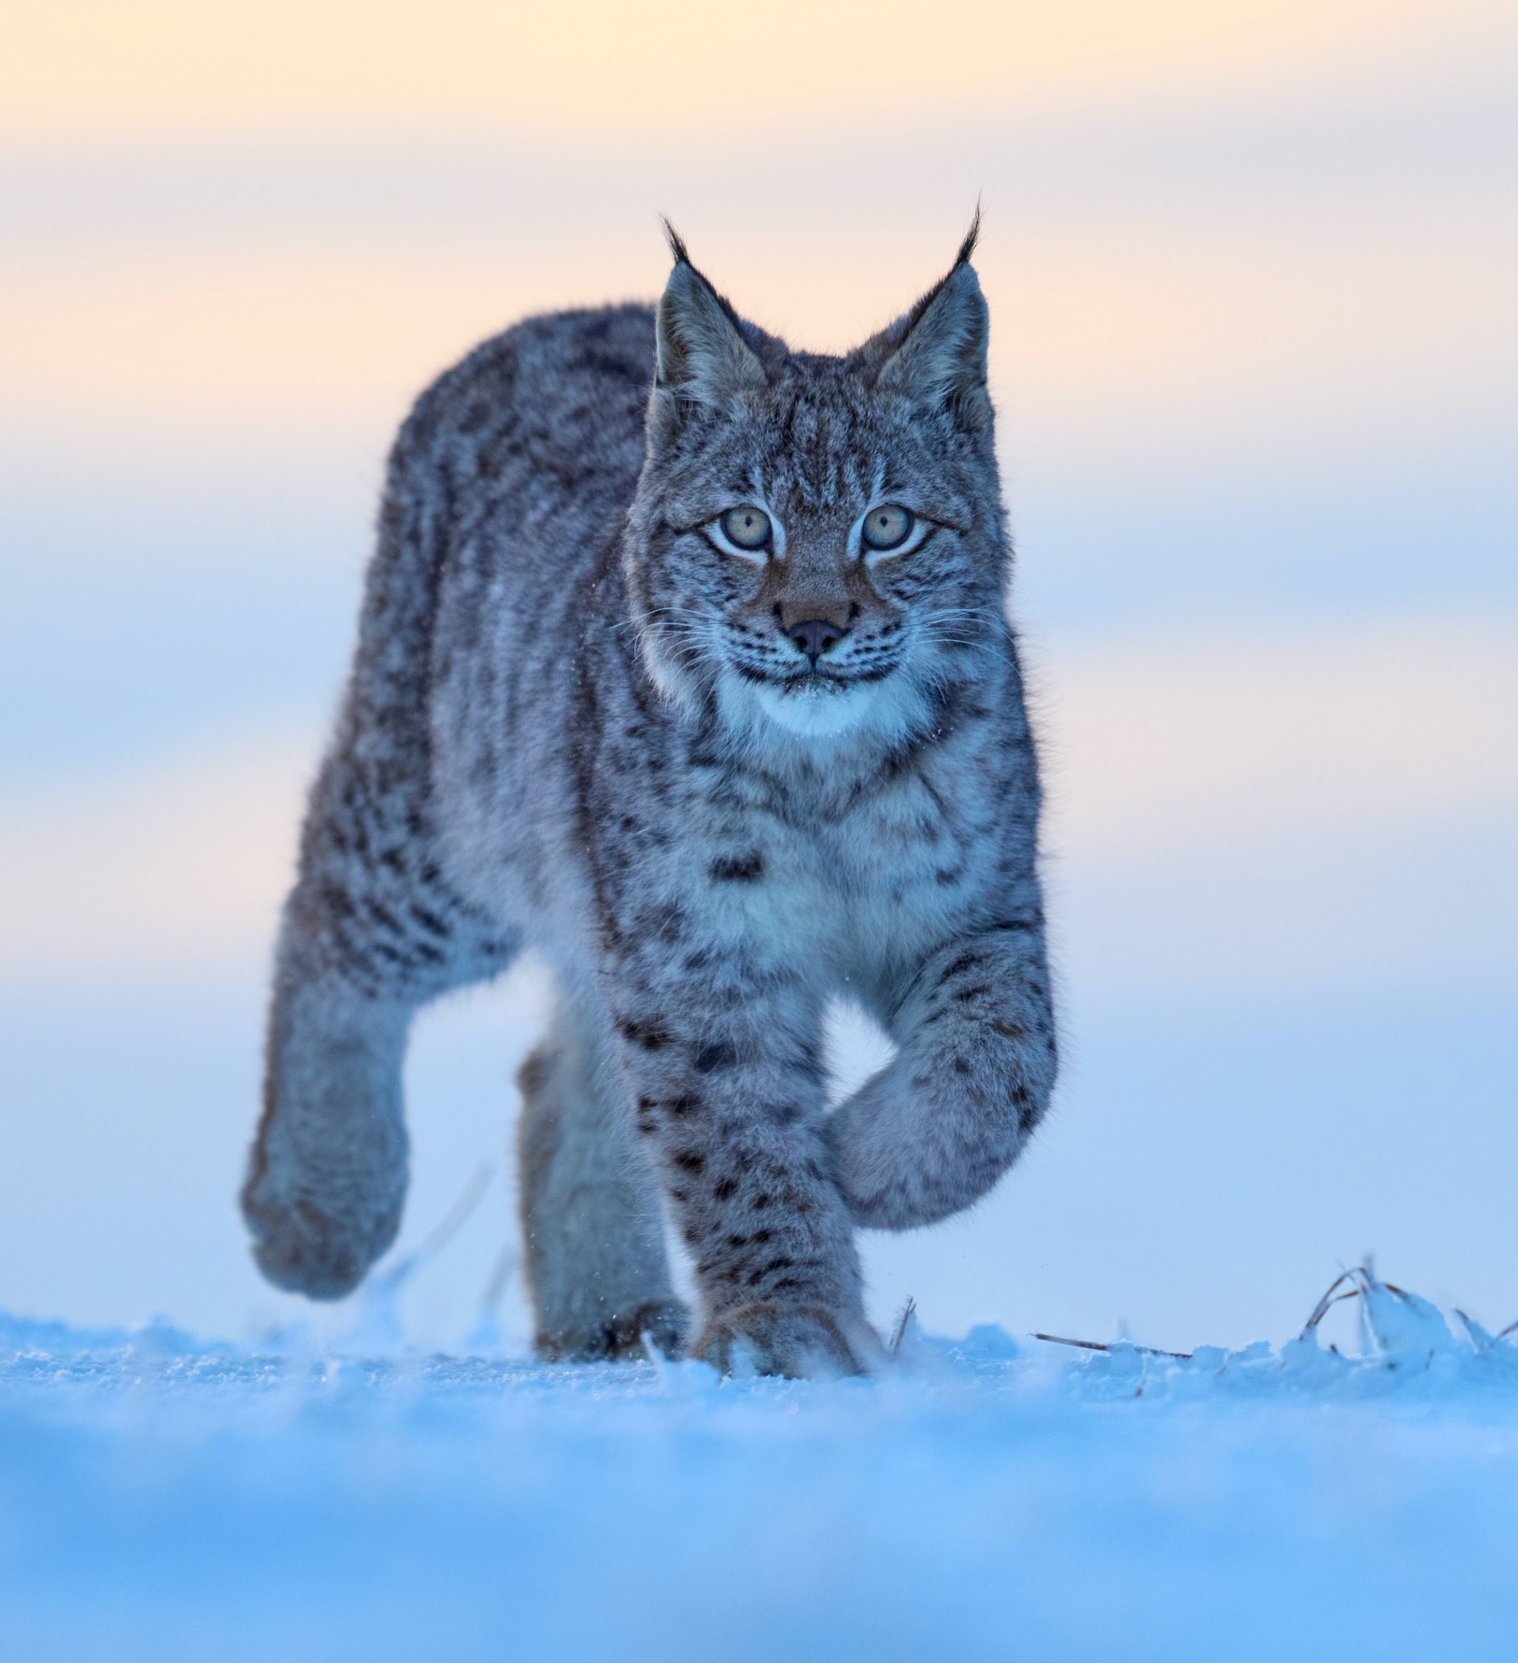
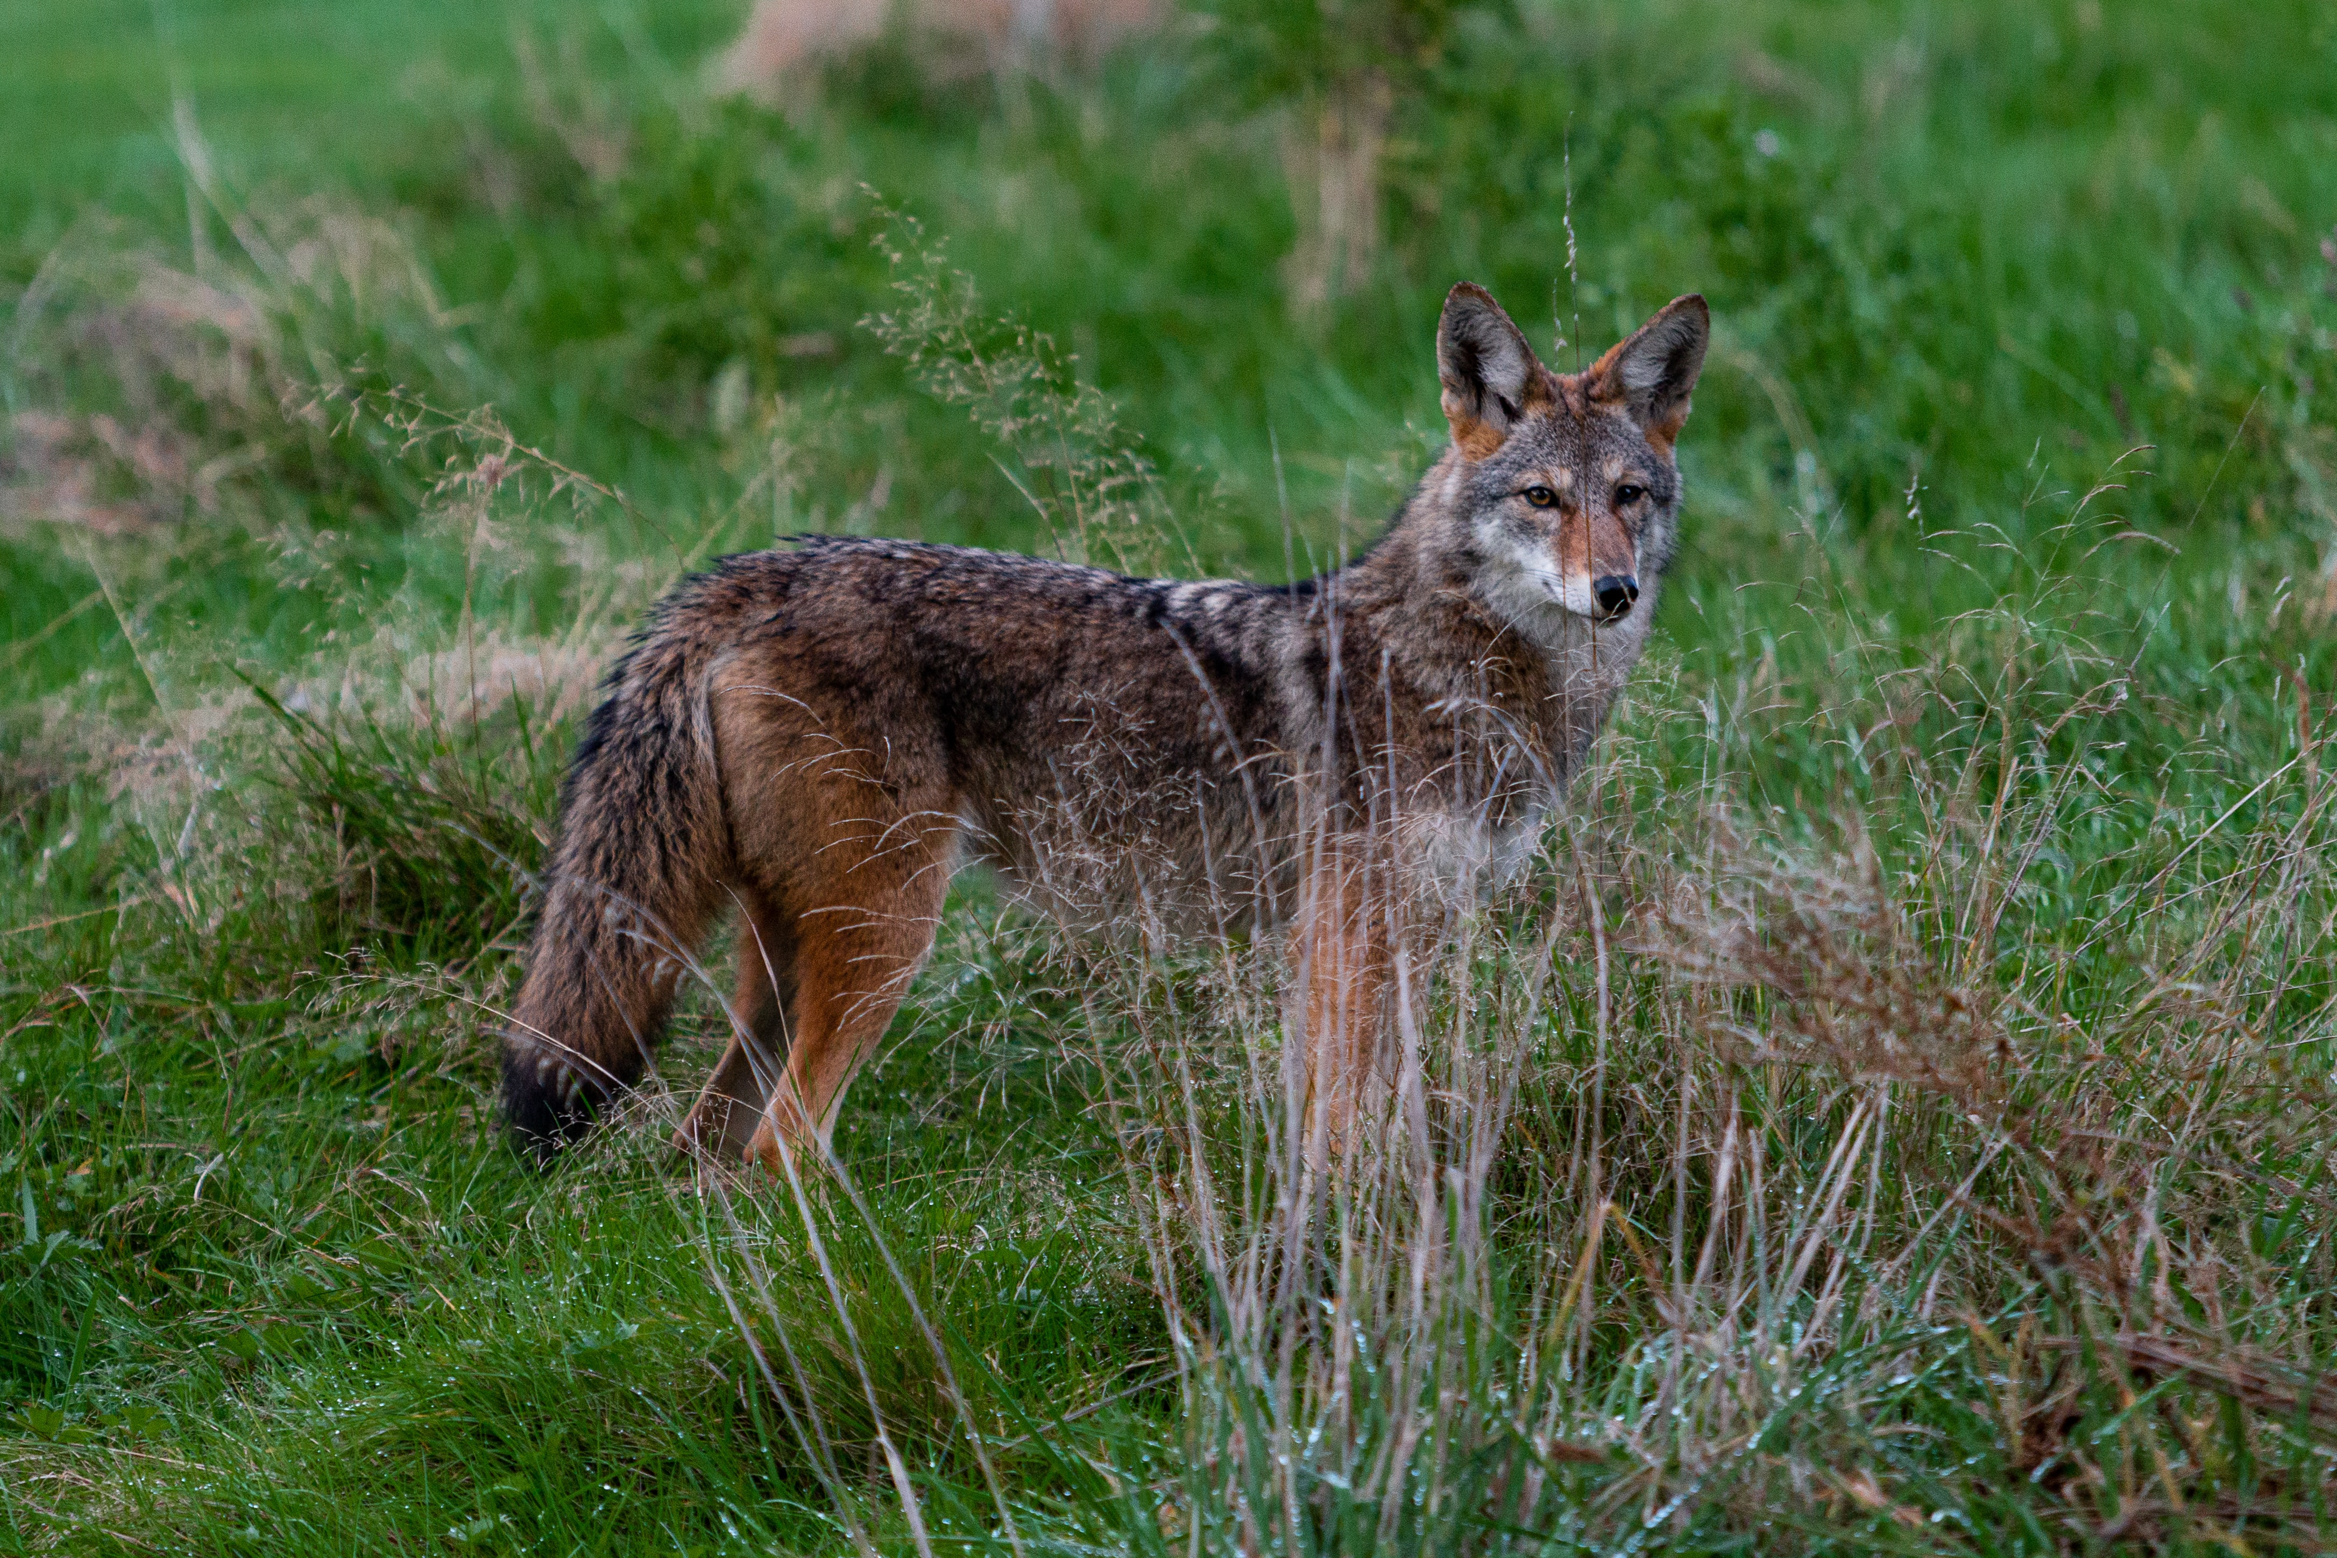
Resource unpredictability and HR: examples in literature
Photo by Liz Guertin on Unsplash
Photo by Hans Veth on Unsplash
(cropped)
HR size (ha)
Seasonality
Photo by Zdeněk Macháček on Unsplash
(cropped)
Photo by Dylan Ferreira on Unsplash
(Nilsen et al. 2005)

Slide 27
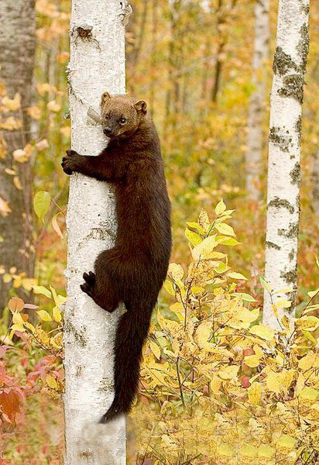
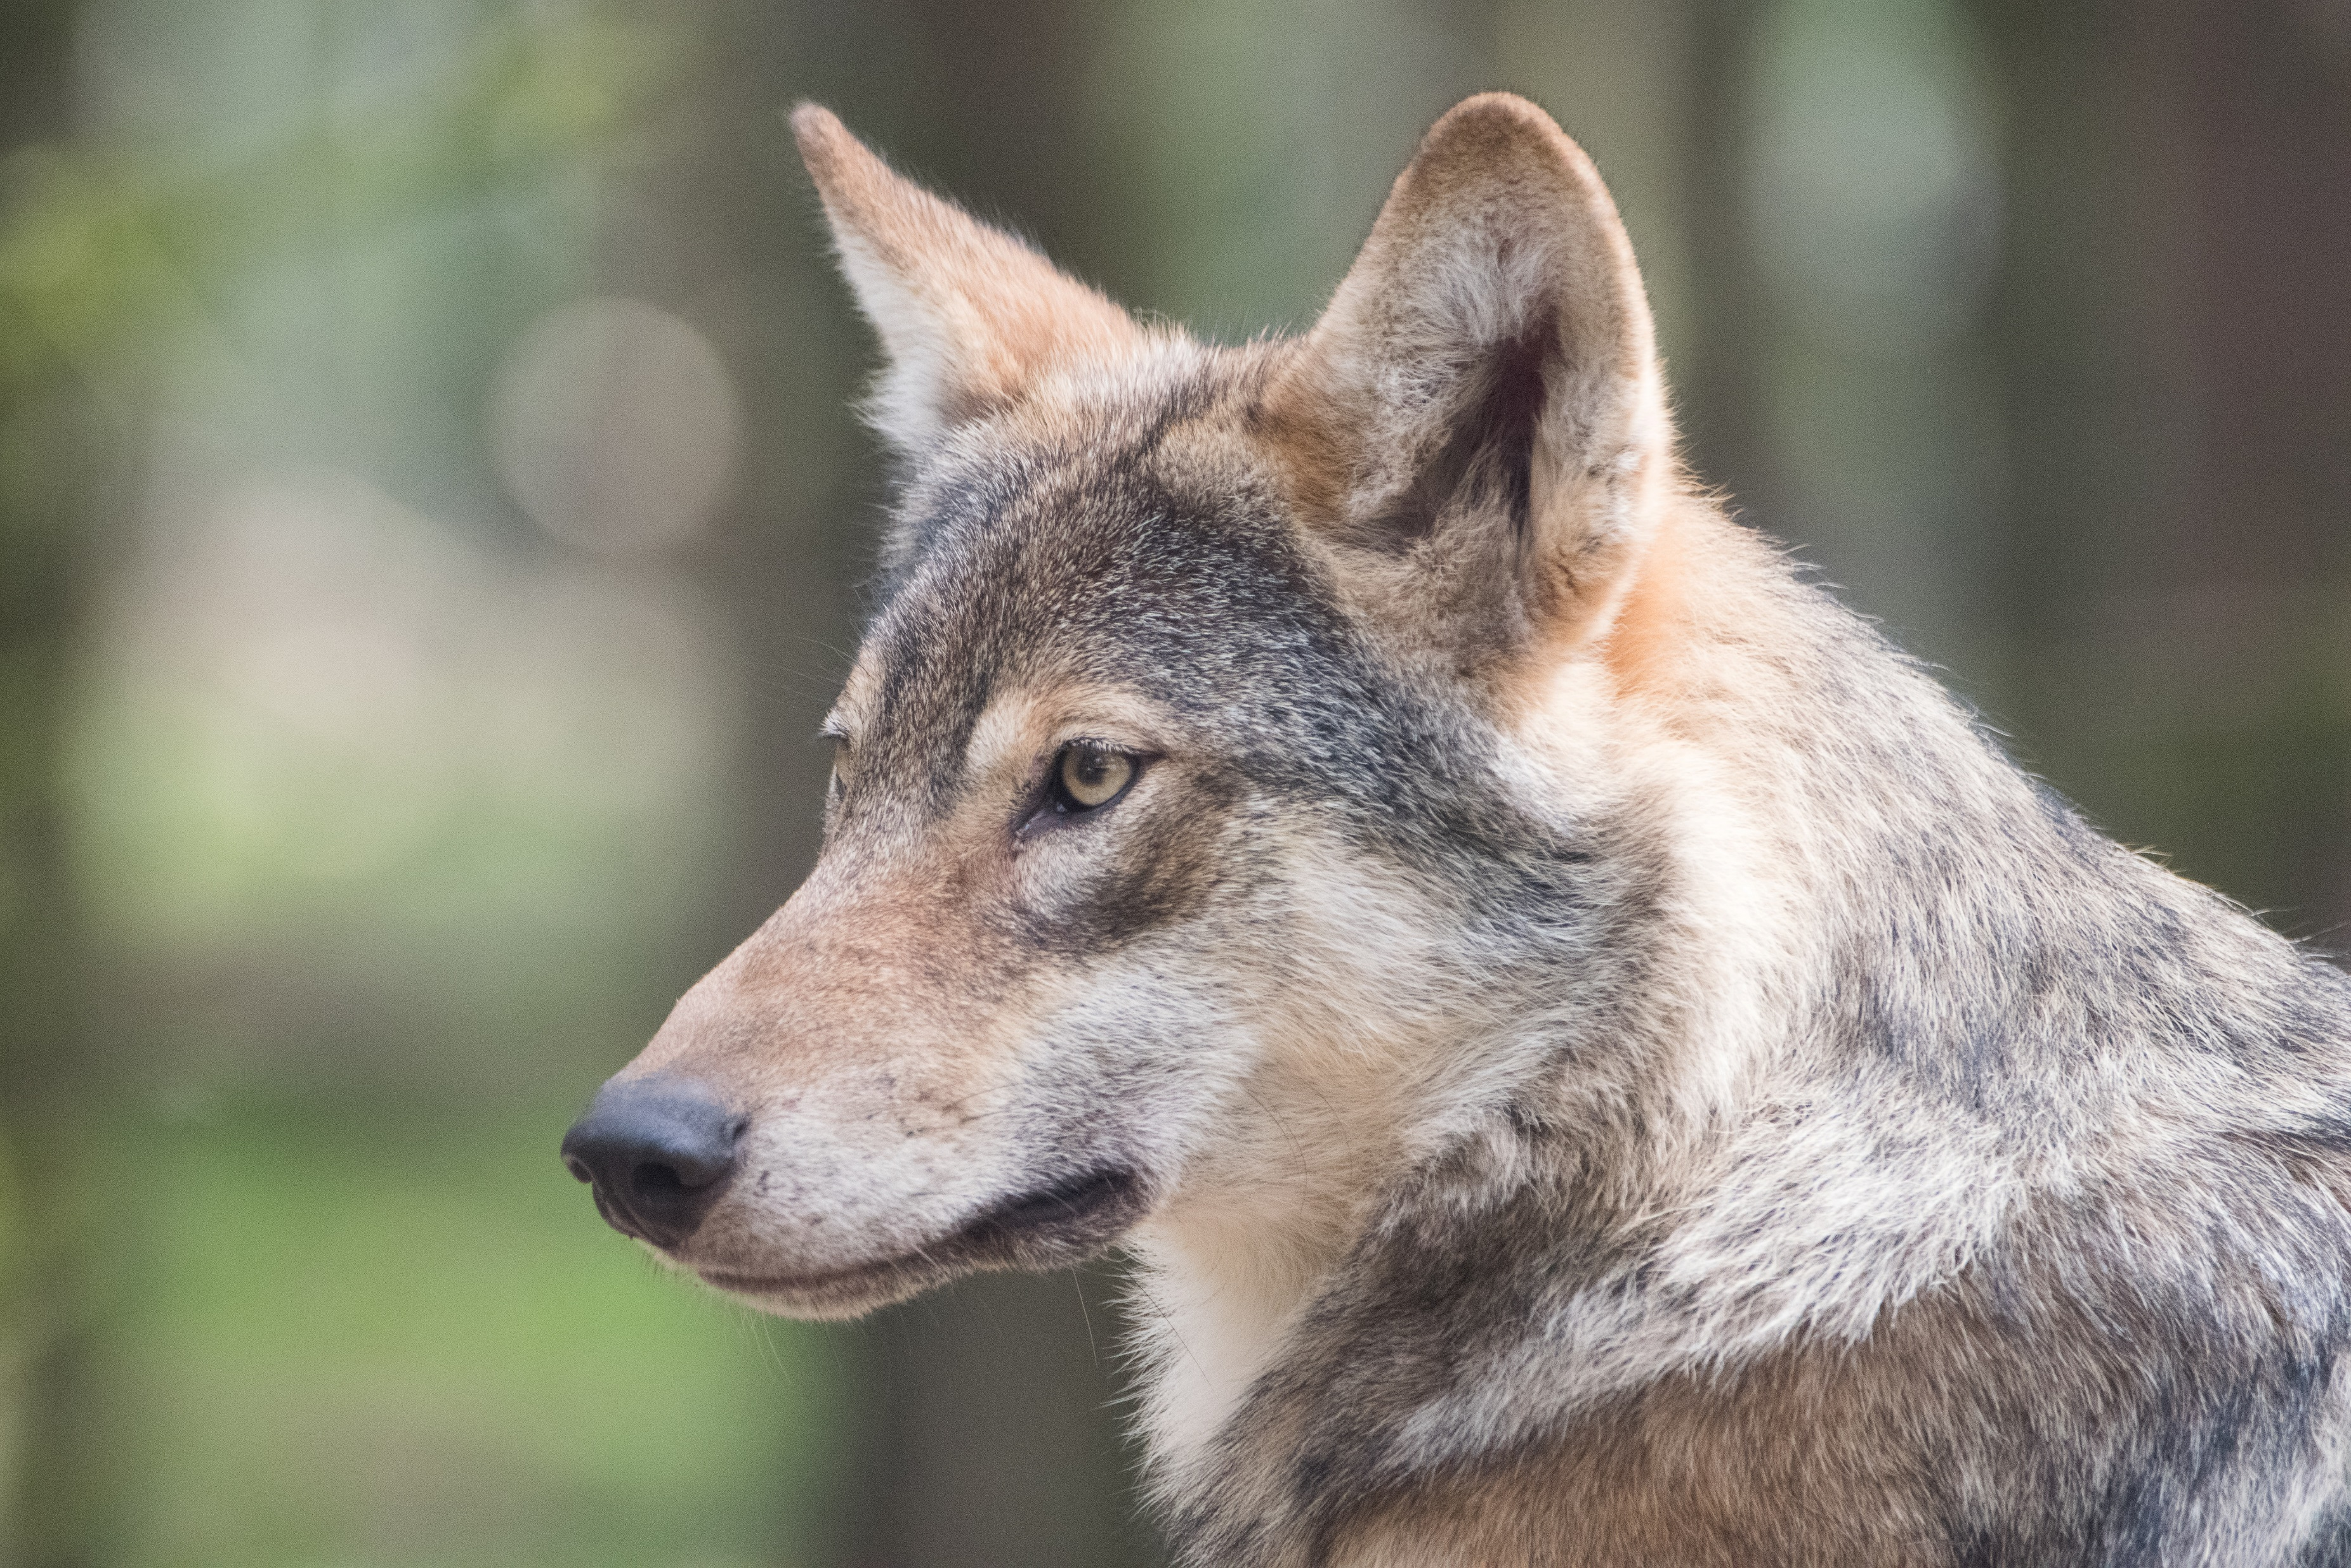
Resource unpredictability and HR: examples in literature
Photo by Douglas H. Domedion on Wikimedia Commons
Photo by M. Zonderling on Unsplash
(Nilsen et al. 2005)

Slide 28
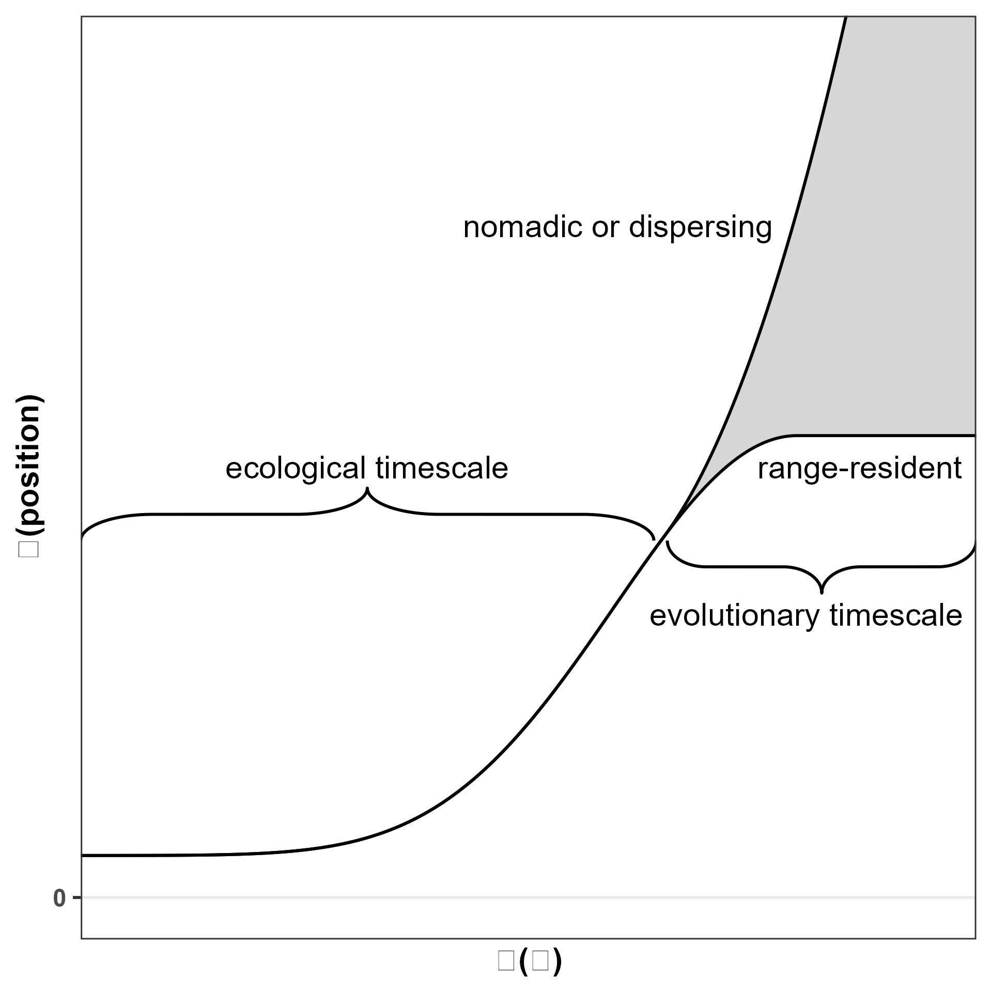
Resource unpredictability and HR: hypothesis
Home range size
Resource unpredictability

Slide 29
Simulating movement

Slide 30
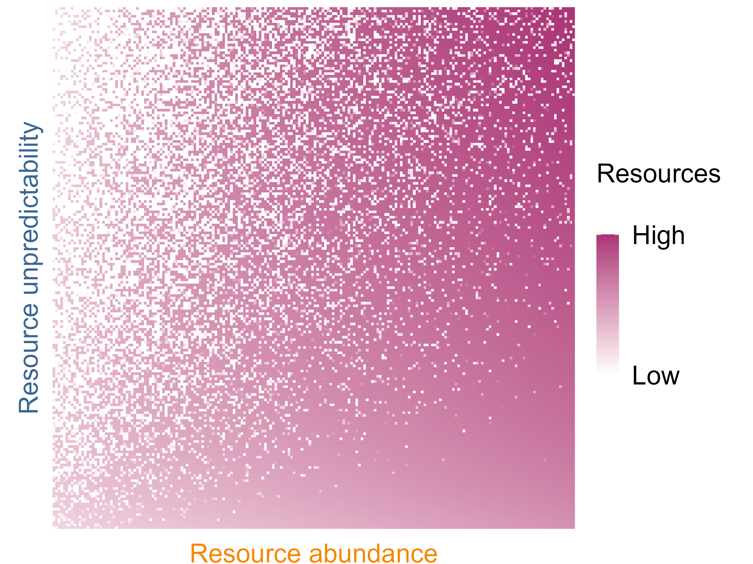
Simulating animal movement

Slide 31
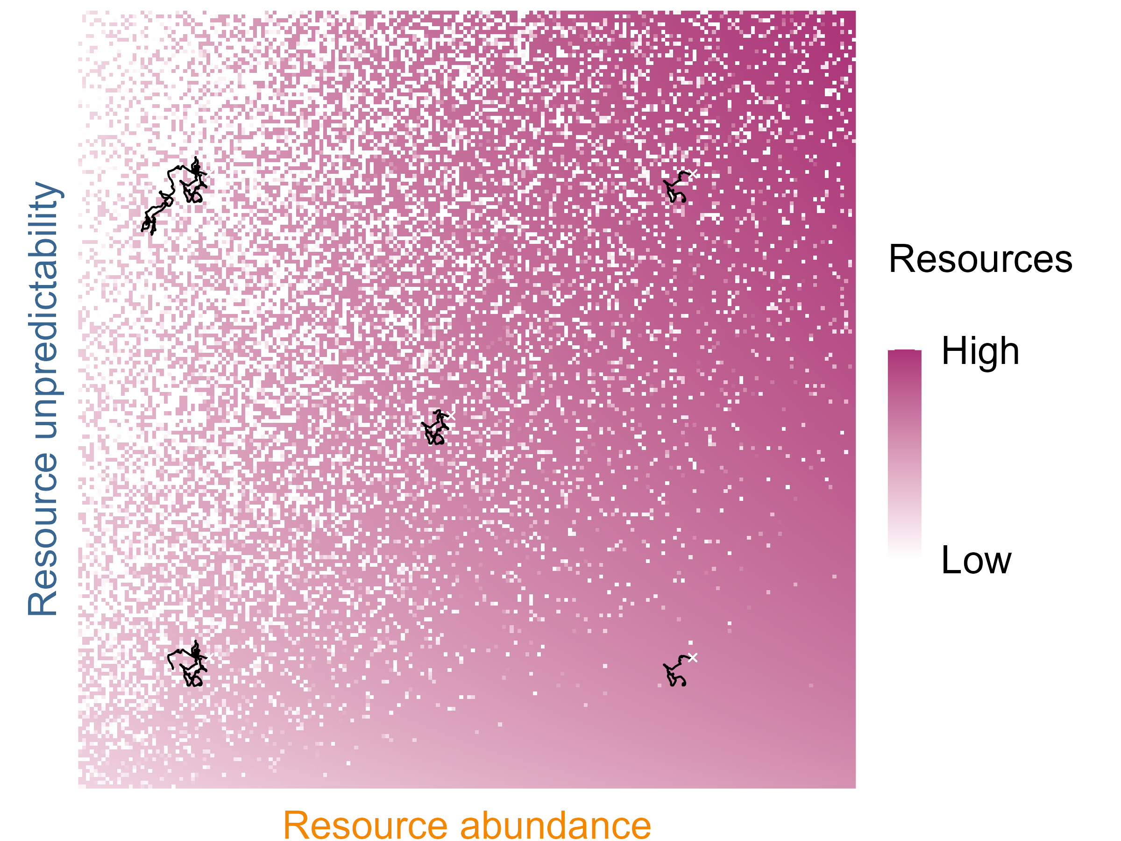
Simulating animal movement

Slide 32
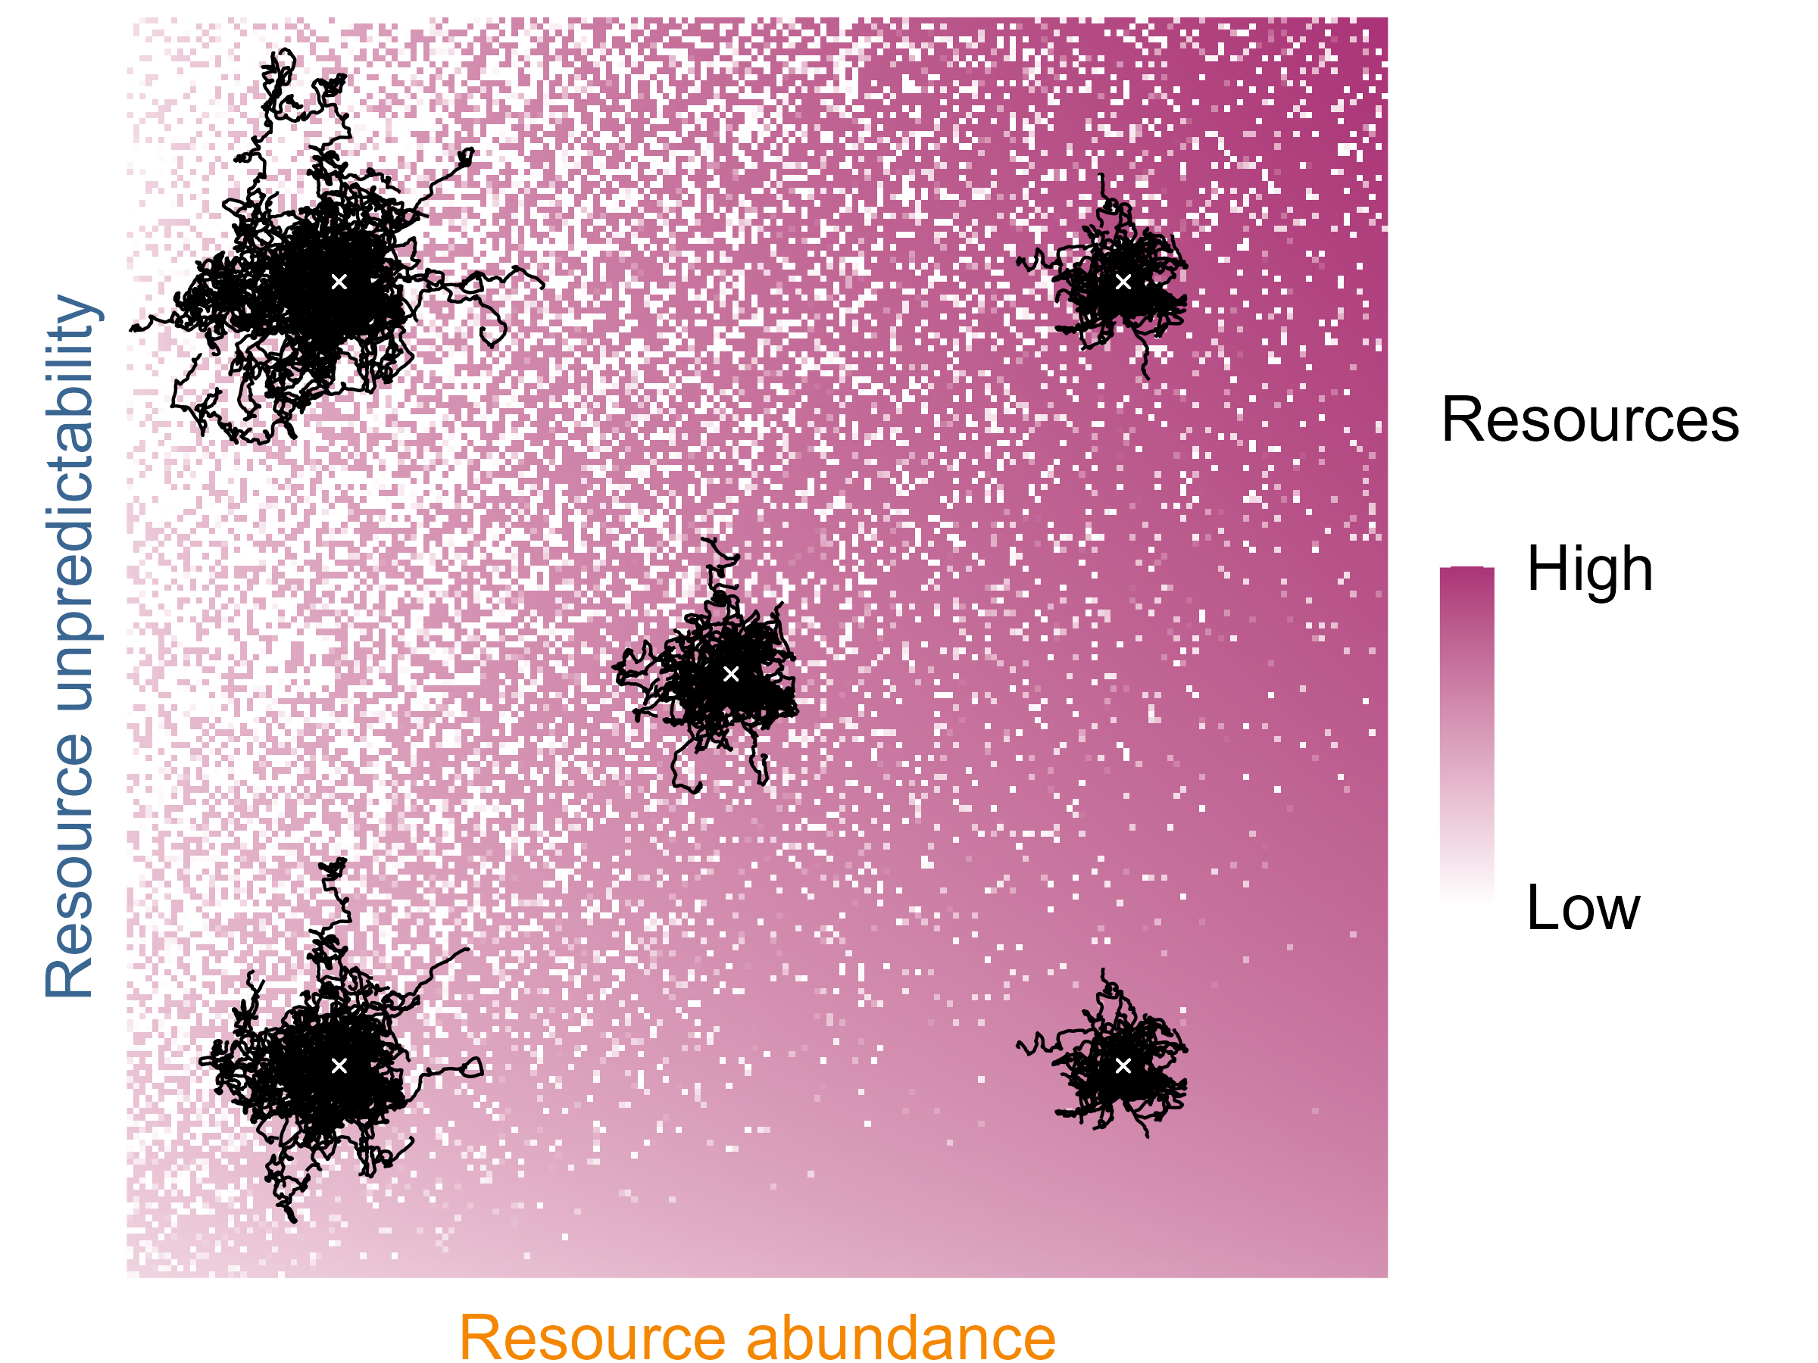
Simulating animal movement

Slide 33
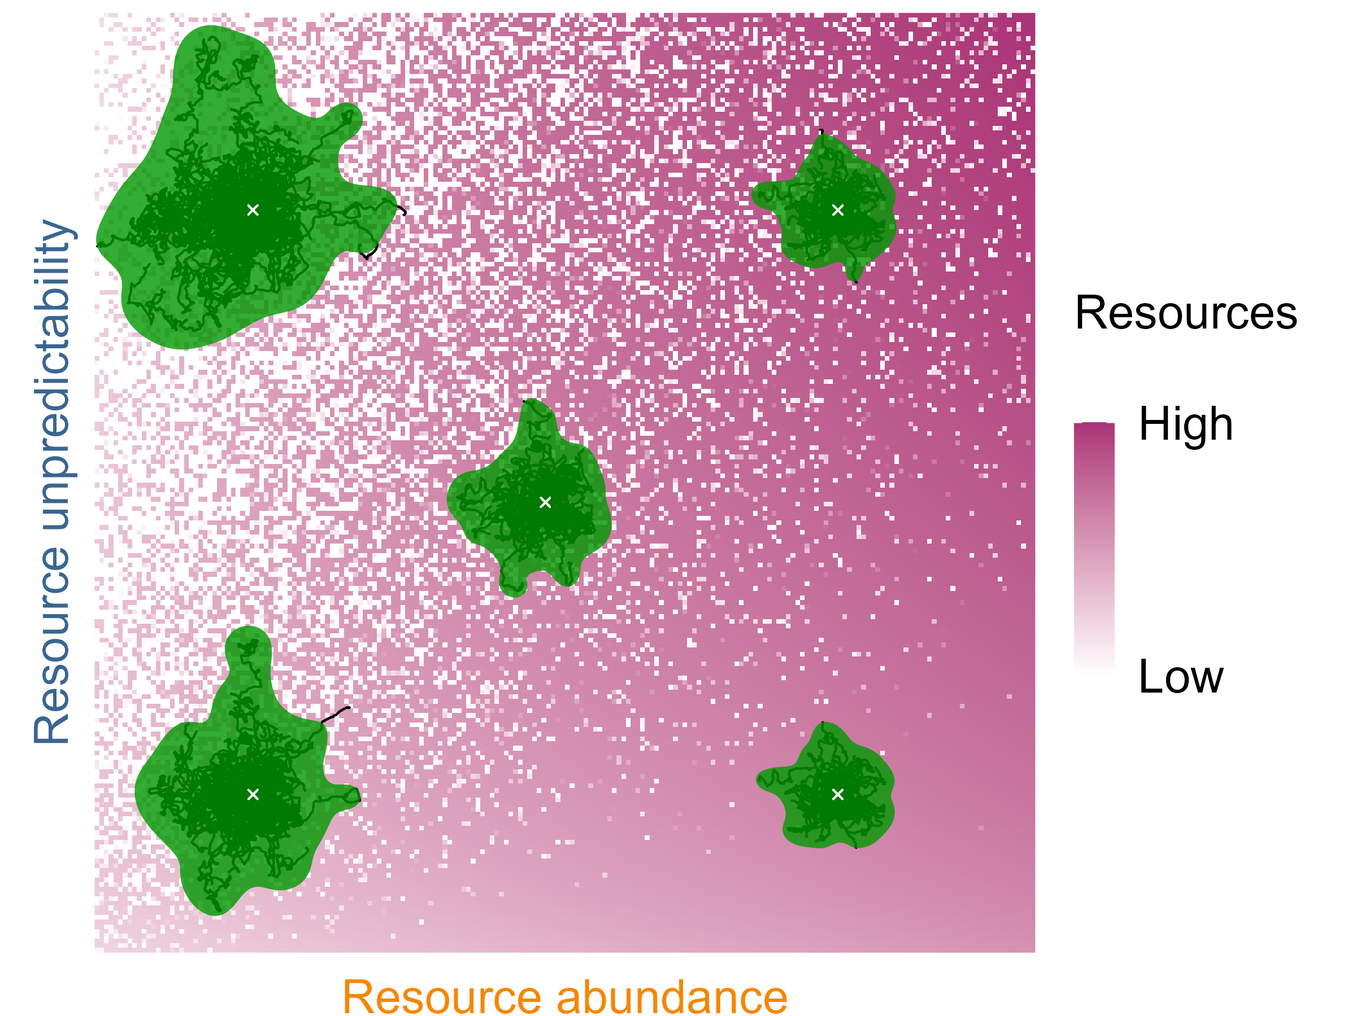
Simulating animal movement

Slide 34
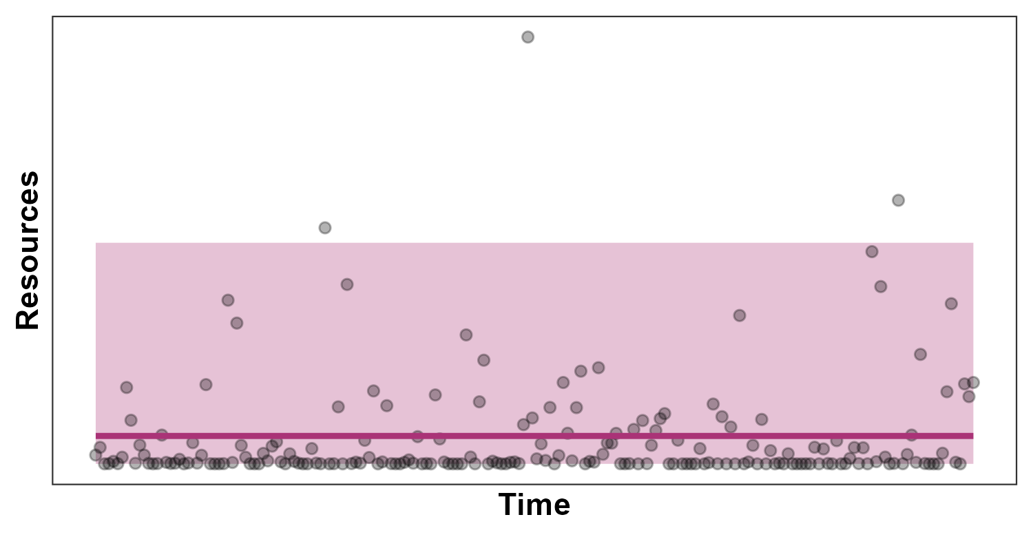
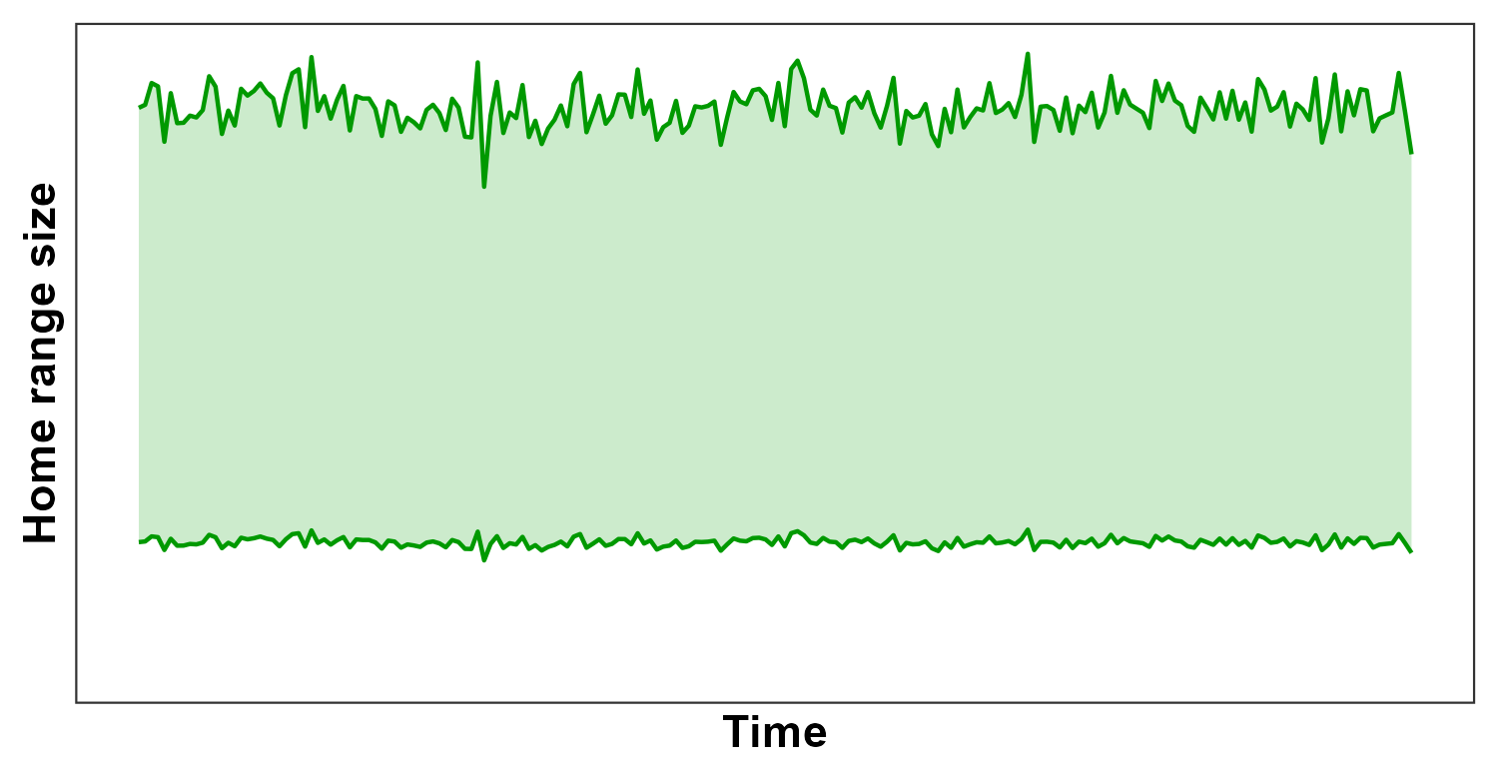
Stationary environments --> constant HR
Constant mean
Constant variance
HR remains constant over time
Resources
Time
HR size
Time

Slide 35
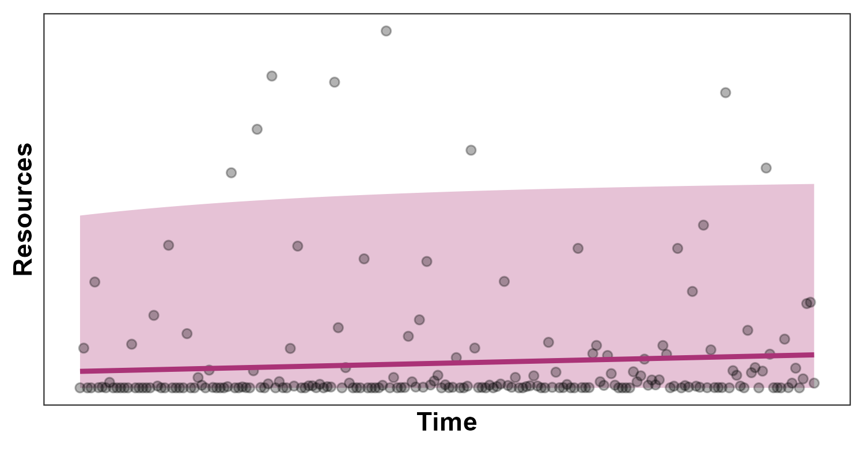
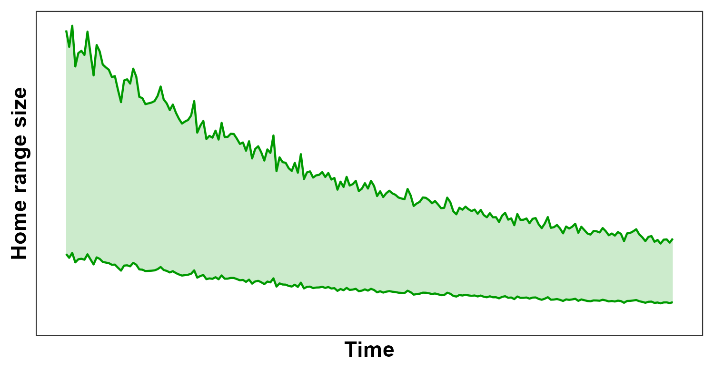
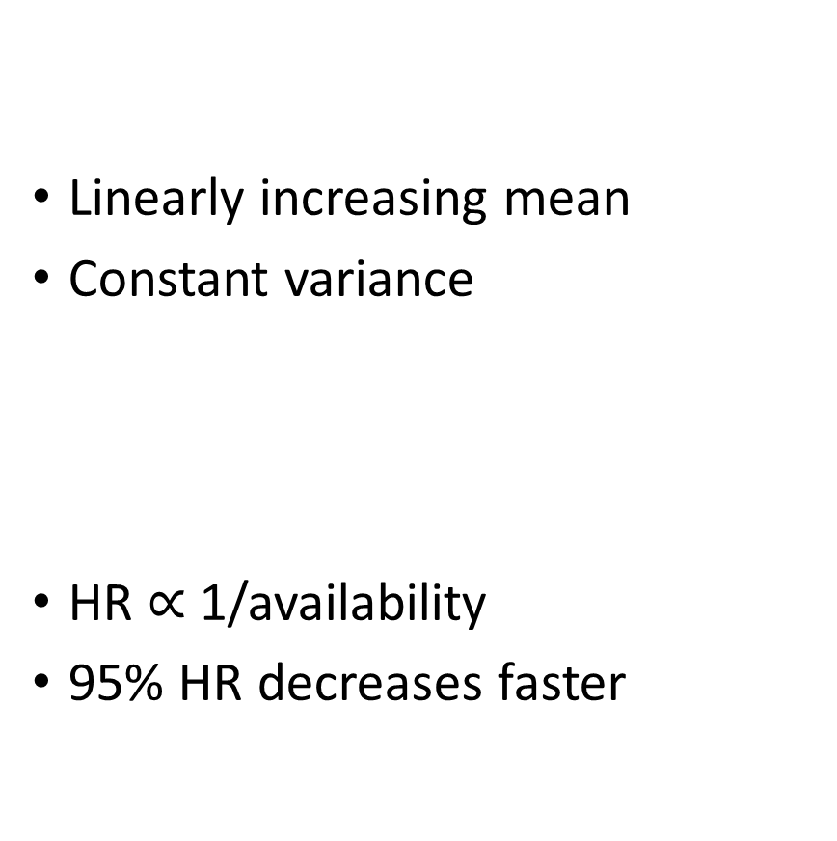
Changing mean --> HR changes rapidly
Linearly increasing mean
Constant variance
HR $∝$ 1/availability
95% HR decreases faster
Resources
Time
HR size
Time

Slide 36
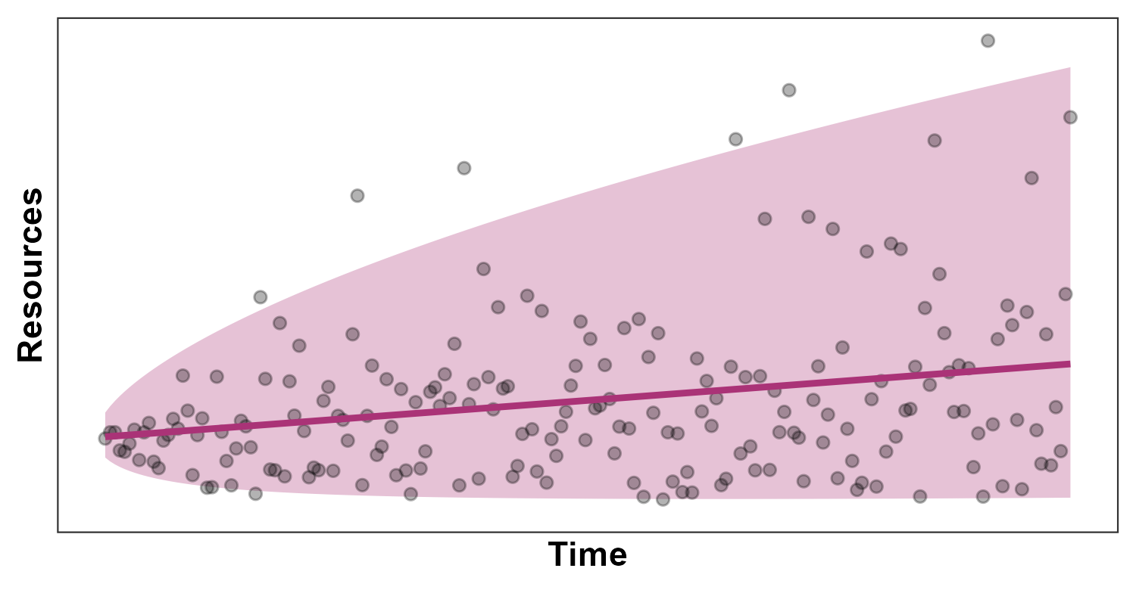
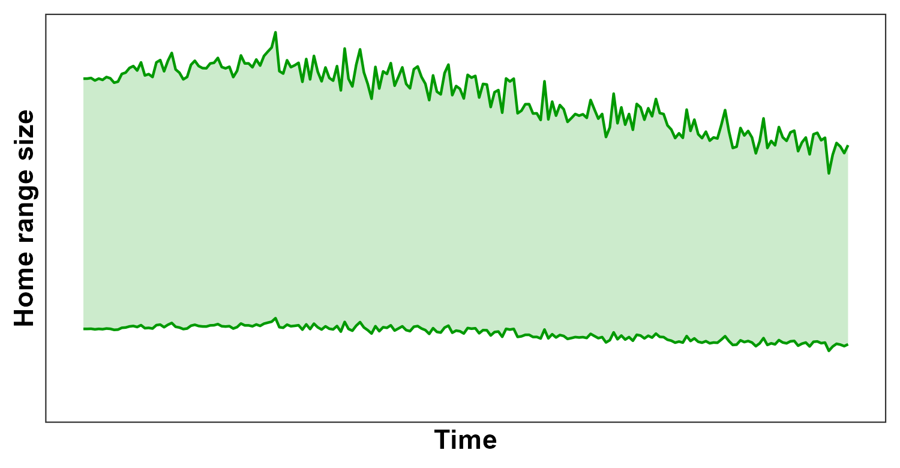
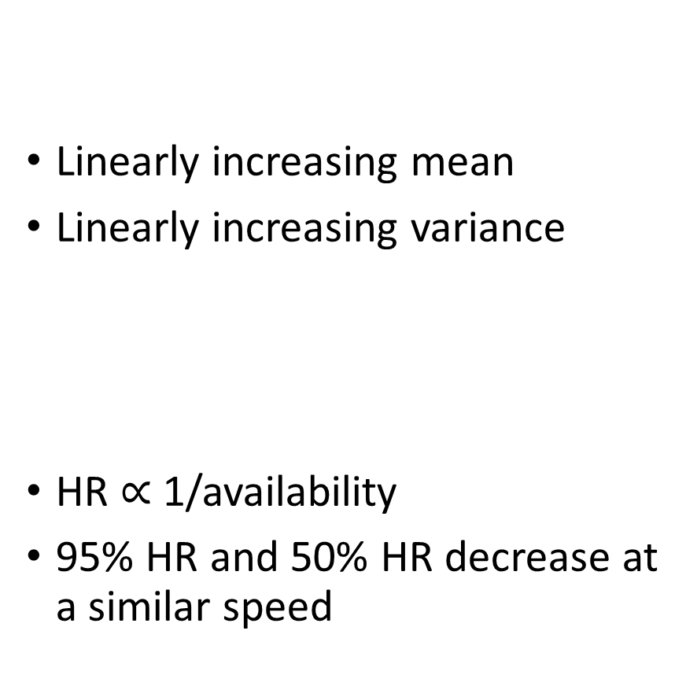
Changes in mean and variance have contrasting effects
Linearly increasing mean
Linearly increasing variance
HR $∝$ 1/availability
95% HR and 50% HR decrease at a similar speed
Resources
Time
HR size
Time

Slide 37
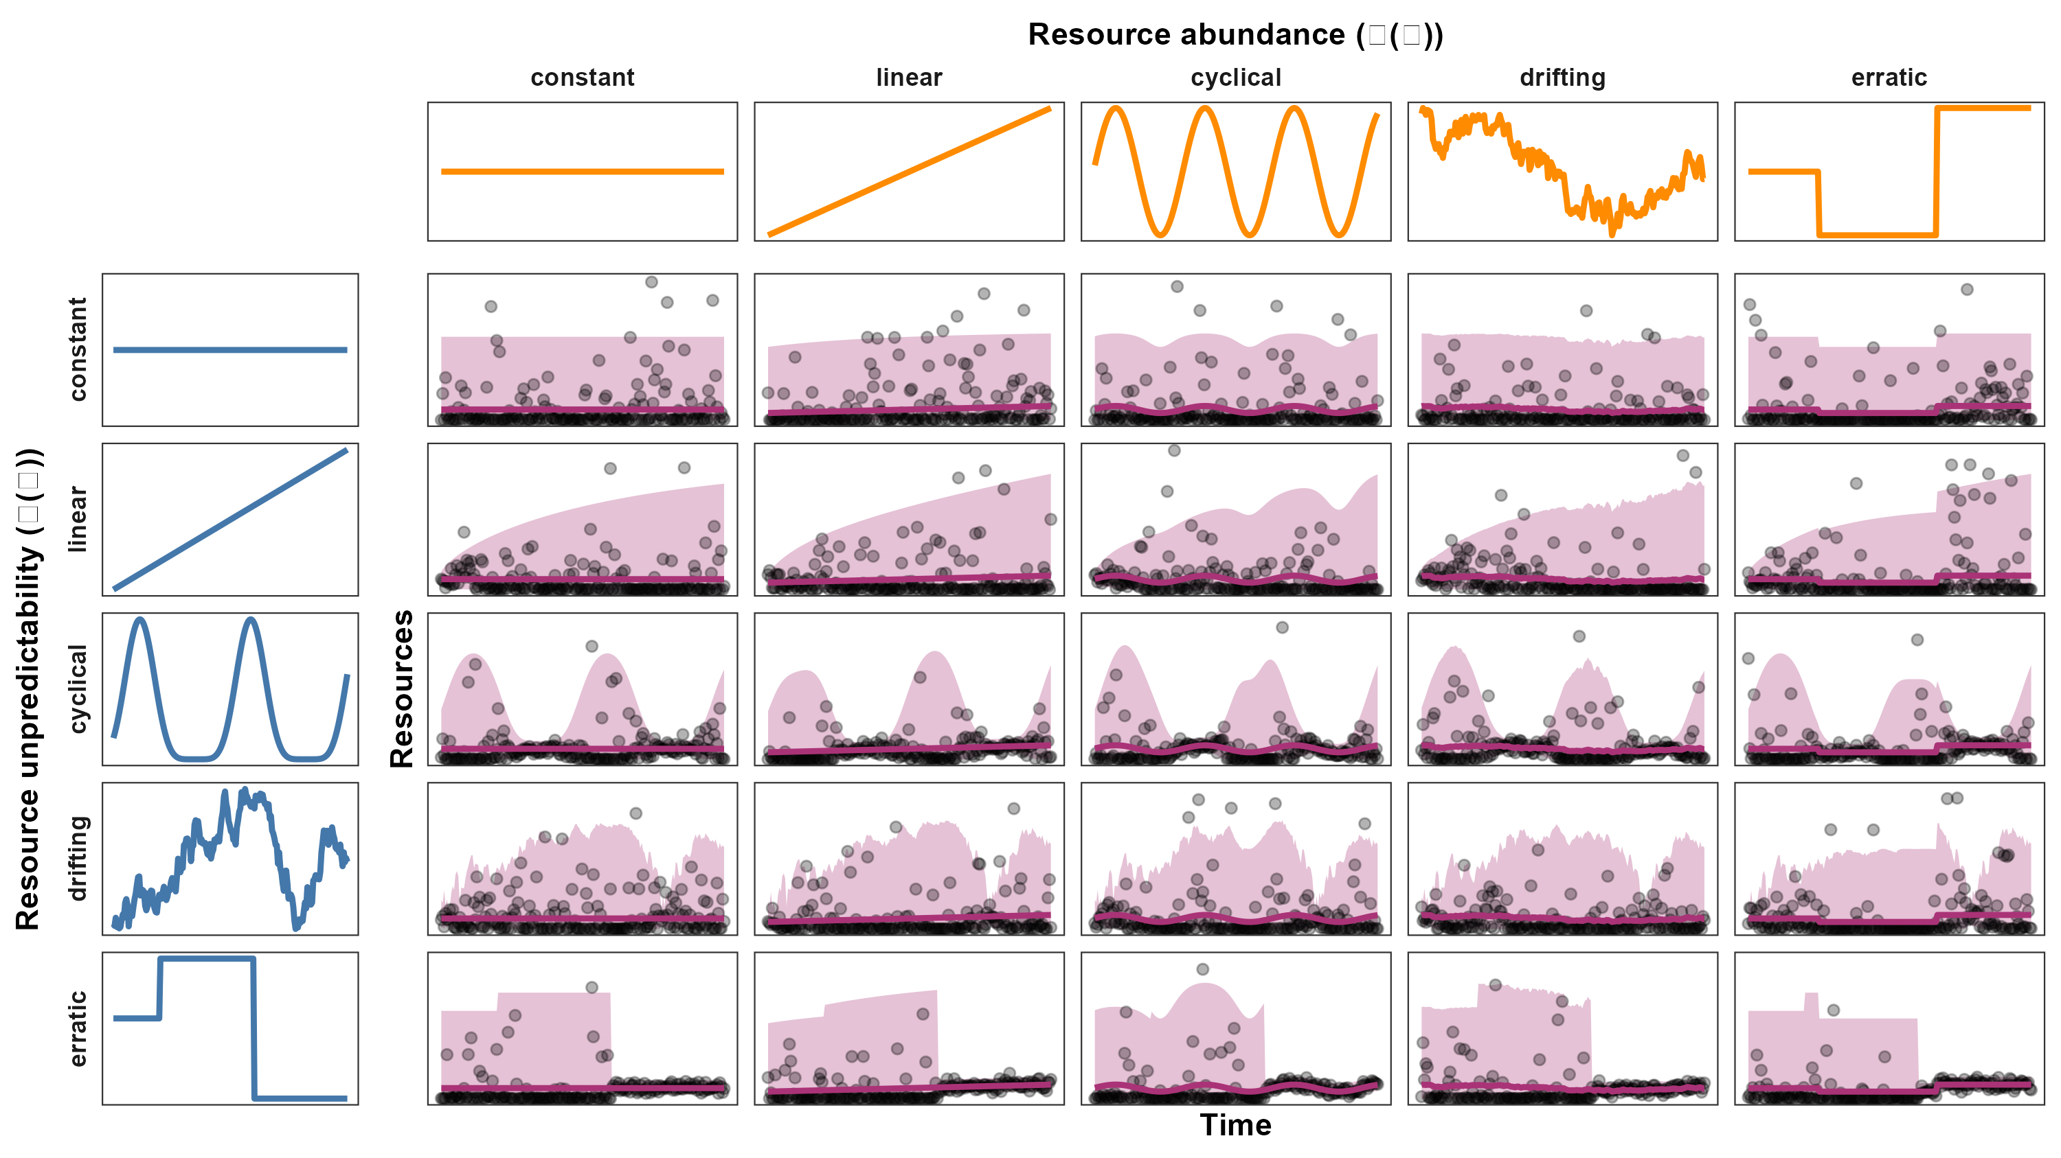
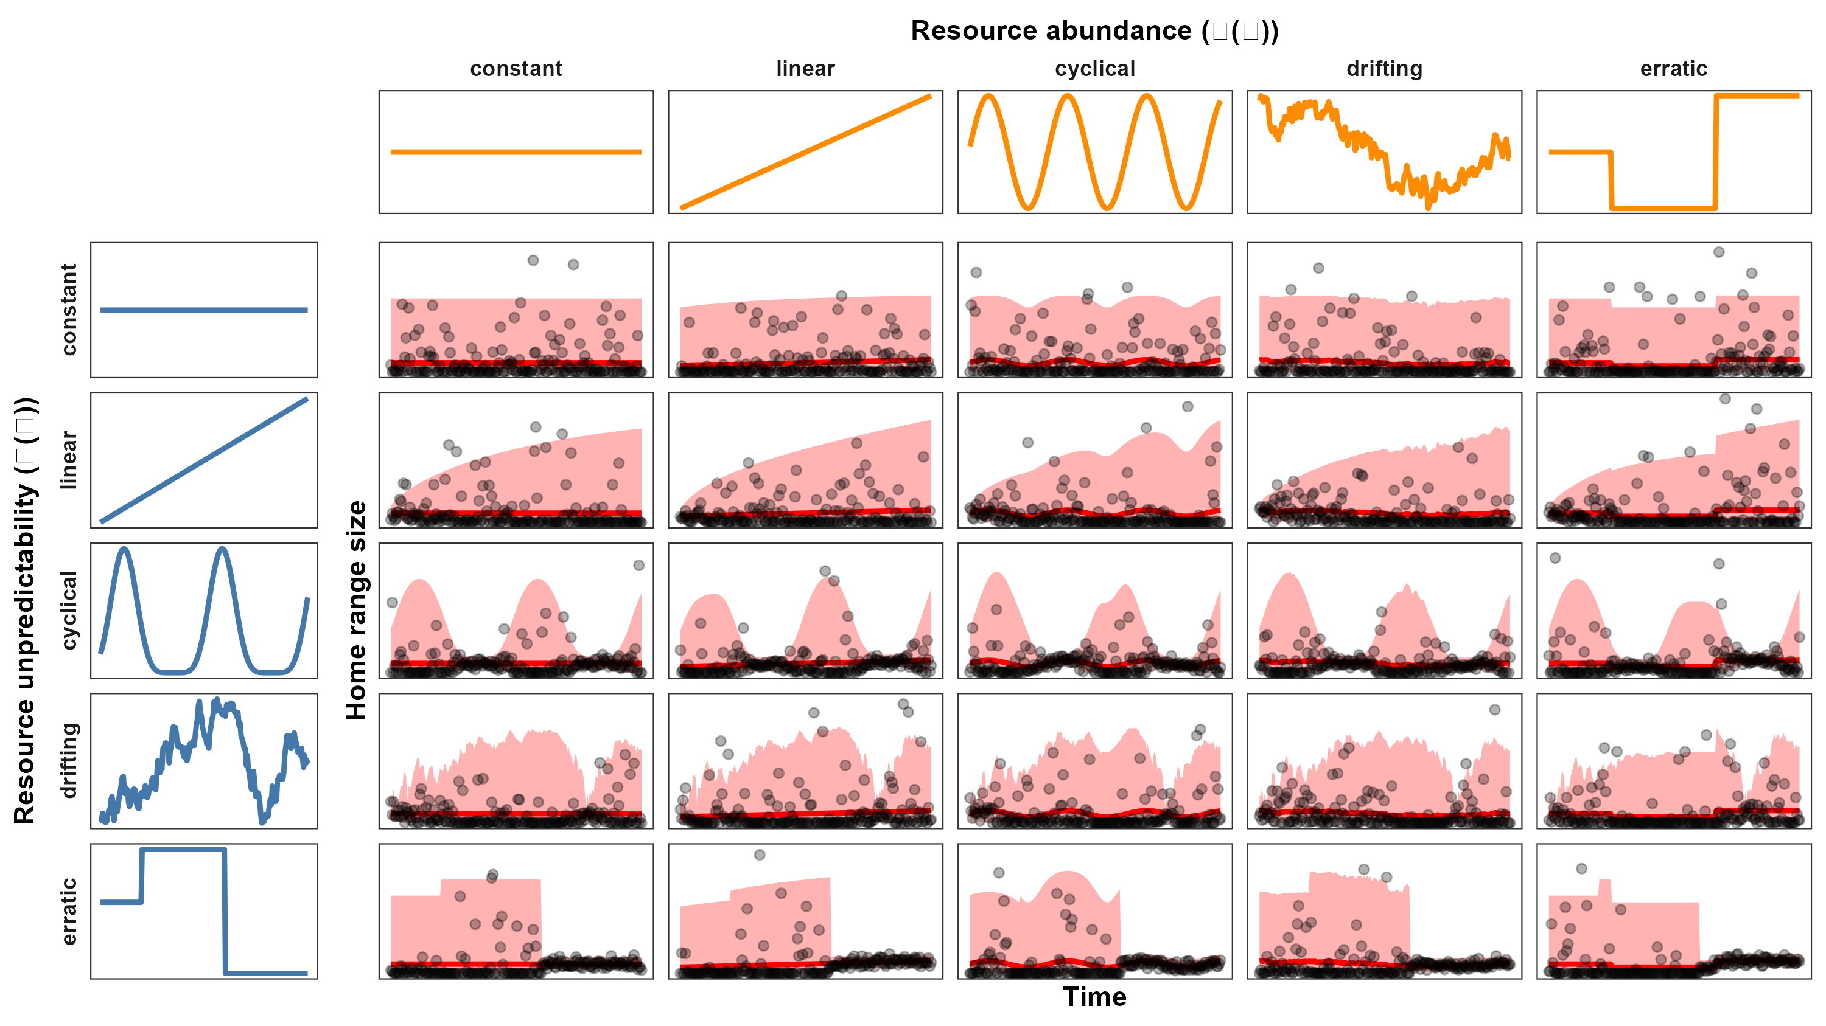
Relationships can be complicated…
Resource abundance
Resource unpredictability
Resources

Slide 38
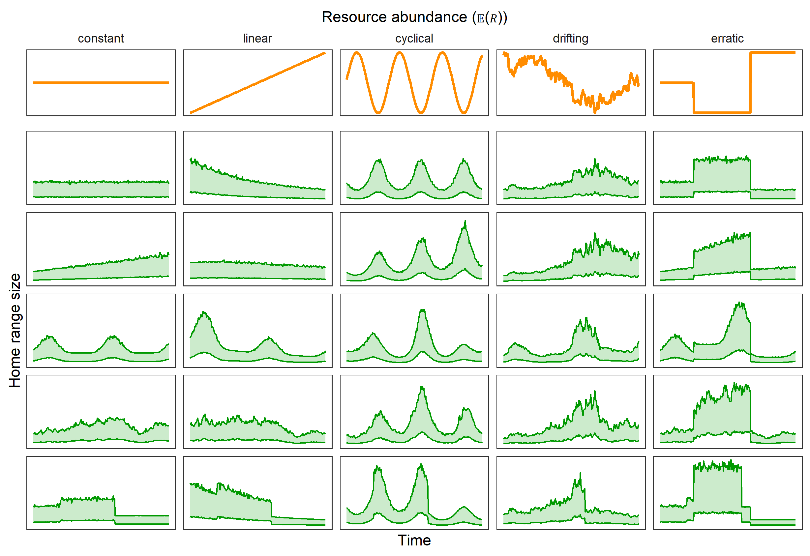
Relationships can be complicated…
Resource abundance
Resource abundance
Resource unpredictability
Home range size

Slide 39

…but they can also be simple!
Home range size
Resource abundance
Resource unpredictability

Slide 40


What’s next?
Run analyses for:
3,000+ animals
85+ species
Estimate behaviors:
Between populations
Between species
Test for common behavior

Slide 41


Summary
Use HR as a catch-all variable for animal’s needs
Home range size:
Decreases nonlinearly with resource abundance
Increases nonlinearly with resource unpredictability
Home range size
Resource abundance
Home range size
Resource unpredictability

Slide 42






Acknowledgements

Slide 43
Summary
Use HR as a catch-all variable for animal’s needs
Home range size:
Decreases nonlinearly with resource abundance
Increases nonlinearly with resource unpredictability
Home range size
Resource abundance
Home range size
Resource unpredictability

Slide 44
References
Bista, D., G. S. Baxter, N. J. Hudson, S. T. Lama, and P. J. Murray. 2022. Effect of disturbances and habitat fragmentation on an arboreal habitat specialist mammal using GPS telemetry: A case of the red panda. Landscape Ecology 37:795–809.
Geremia, C., J. A. Merkle, D. R. Eacker, R. L. Wallen, P. J. White, M. Hebblewhite, and M. J. Kauffman. 2019. Migrating bison engineer the green wave. Proceedings of the National Academy of Sciences 116:25707–25713.
Herfindal, I., J. D. C. Linnell, J. Odden, E. B. Nilsen, and R. Andersen. 2005. Prey density, environmental productivity and home-range size in the Eurasian lynx (Lynx lynx). Journal of Zoology 265:63–71.
Lucherini, M., and S. Lovari. 1996. Habitat richness affects home range size in the red fox Vulpes vulpes. Behavioural Processes 36:103–105.
Nilsen, E. B., I. Herfindal, and J. D. C. Linnell. 2005. Can intra-specific variation in carnivore home-range size be explained using remote-sensing estimates of environmental productivity? Écoscience 12:68–75.
Relyea, R. A., R. K. Lawrence, and S. Demarais. 2000. Home Range of Desert Mule Deer: Testing the Body-Size and Habitat-Productivity Hypotheses. The Journal of Wildlife Management 64:146.
Rickbeil, G. J. M., J. A. Merkle, G. Anderson, M. P. Atwood, J. P. Beckmann, E. K. Cole, A. B. Courtemanch, et al. 2019. Plasticity in elk migration timing is a response to changing environmental conditions. Global Change Biology 25:2368–2381.
Rizzuto M., Leroux S.J., Vander Wal E., Richmond I.C., Heckford T.R., Balluffi-Fry J., et al. (2021). Forage stoichiometry predicts the home range size of a small terrestrial herbivore. Oecologia 197, 327–338.
Williams-Guillen, K., C. McCann, J. C. Martinez Sanchez, and F. Koontz. 2006. Resource availability and habitat use by mantled howling monkeys in a Nicaraguan coffee plantation: Can agroforests serve as core habitat for a forest mammal? Animal Conservation 9:331–338.

